Slide 1
HCE State Conference
Understand ACEs
Adversity in Childhood-A Community Perspective
September 18th, 2018
Mandi Dornfeld
Human Development Family Relationship Educator
Winnebago County UW-Extension

Slide 2
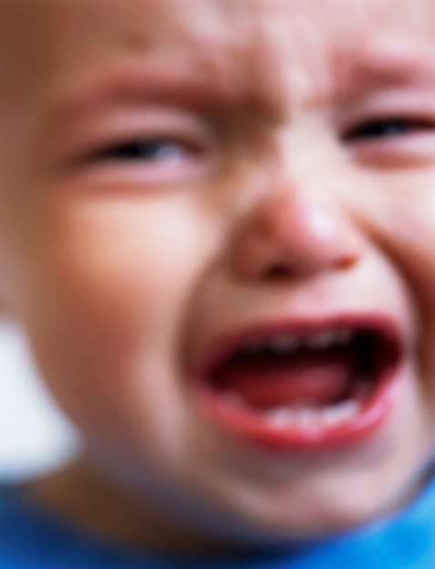
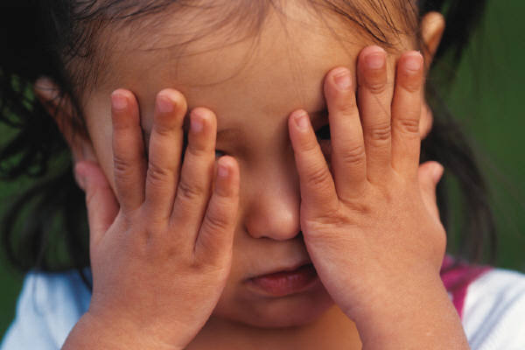
What Are ACEs? Adverse Childhood Experiences
ACEs are experiences in childhood that threaten or harm physical or emotional integrity of the child or someone close to them, overwhelm the ability to respond, and create significant difficulty in functioning.
Notes:
2

Slide 3
The ACE Study
The largest study of its kind ever to examine - over the lifespan - the medical, social, and economic consequences in adults of adverse childhood experiences
Demographics:
Primary care setting
Median age: 57 yr. old
Educated: 39% college grads, 36% some college
Middle class / living wage jobs with insurance
Predominantly white: 75% Caucasian
Confidential survey asking questions about childhood trauma and current health status and behaviors combined with physical examination

Slide 4
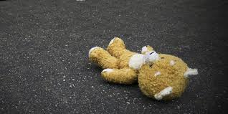
ACEs – Measured in Original Study Occurring before the age of 18
Abuse
Child physical abuse
Child sexual abuse
Child emotional abuse
Neglect
Physical Neglect
Emotional Neglect
Exposure to other traumatic stressors
Mentally ill, depressed or suicidal person in the home
Drug addicted or alcoholic family member
Witnessing domestic violence against the mother
Loss of a parent to death or abandonment, including abandonment by divorce
Incarceration of any family member
Most recent data shows that all ACE categories are equally destructive

Slide 5
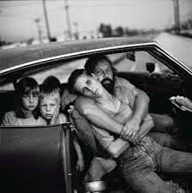
Expanded ACE Definitions: Incorporating community adversity measures for low-income urban youth
Lack of love and support in the family
Death/illness of family members
Poor parenting and lack of guidance
Neighborhood crime, violence and death
Negative adult behavior in the neighborhood
Neighborhood nonviolent crime
Bullying
Not enough money
Lack of nonmonetary resources (hunger, homelessness, poor-quality clothing)
Stereotypes, racism, discrimination

Slide 6
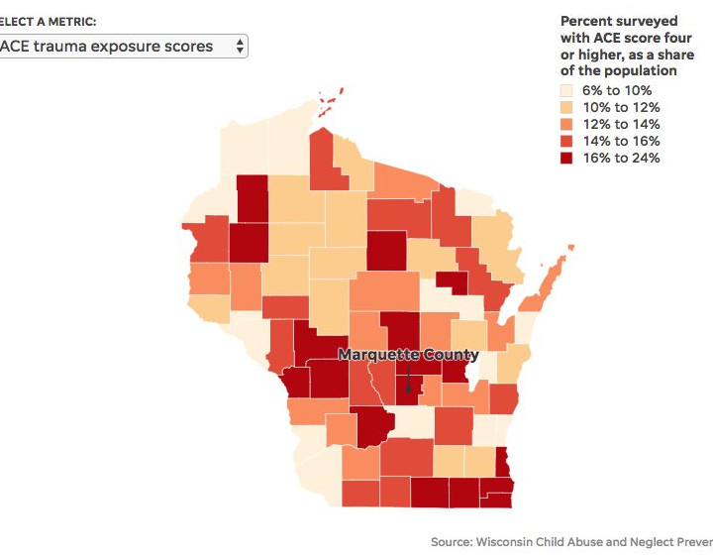

Slide 7
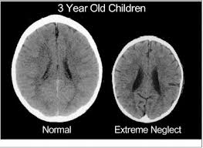
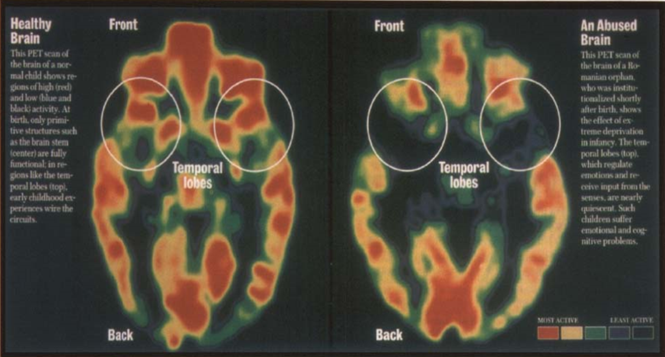

Slide 8
Brains to Fit the Life We’ll Live
DEVELOPMENT
for a tough life:
Emotion processing regions smaller, less efficient
Efficient production of stress-related chemicals
Dysregulated happy hormones
Fewer receptors for calming
Less white matter
INDIVIDUAL
characteristics & traits
Competitive
Hot tempered
Impulsive
Hyper vigilant
“Brawn over brains” or
Withdrawn
Emotionally detached
Numb
WHY IT WORKS
Under the worst conditions, such as war & famine, both the individual & the species survive.
Toxic Stress
Assuming a
neutral start:
All brains will adapt to survive
DEVELOPMENT
for a good life:
Emotion processing regions robust and efficient
Abundant happy hormones
High density white matter, especially in midbrain
WHY IT WORKS
By striving for cooperative relationships, individual & species live peacefully.
INDIVIDUAL
characteristics & traits
Laid back
Relationship-oriented
Reflective
“Process over power”
Notes:
This is how Dr. Teicher’s research rolls up.
All brains are made to adapt in response to the environment and stressors in the environment. This is normal. In a perfect world, this process ensures a good fit between the individual and the environment. It also means our experience becomes part of our biology.
Adaptations in the shape of the brain’s key regions, chemistry and the electrical grid result in predictable patterns of development in behavior, disposition and other characteristics.
On the whole, we can expect a high stress child to arrive at school ready to compete—ready to push others out of the way to get what he wants or needs. His temper will heat up quickly and cool off slowly. He expects danger at every turn, so he may pay more attention to other people than he does to books. And he’s unlikely to sit still. After all sitting still IS a sitting duck.
Our society tends to see these things as bad or broken. But when you take the larger view, this adaptation has value. Being ready, willing and able to respond to danger helps the species survive in difficult times. People who are wired with these characteristics are incredibly good in a crisis. They can respond quickly and decisively.
We may tend to see the bottom track, where people are laid-back and relationship oriented as “good.” And it certainly can be easier to manage children who want to be cooperative and get along and keep the peace.
But that’s not always useful. Raise your hand if you have ever worried about a kid because he or she had no “street smarts” or was way too trusting of other people? These “good” characteristics are helpful in times of peace and plenty. But not so much in times of danger.
Both pathways are normal. Both pathways are about the biology that is inside of us. And both pathways have up sides and down sides.
Our culture is pretty good at helping people on the bottom pathway build needed skills. For example, we teach stranger danger and self defense.
But what do we do for the kids on the top path? Do we make a real effort to teach a hot head how to use his constant search for competition and danger in ways that are socially and economically valued? Or do we suspend him from school when he’s hard to manage?
Also a possible other path – flat affect – Seligman’s learned helplessness - touch on difference between males (conduct disorder) and females (mood disorders)

Slide 9
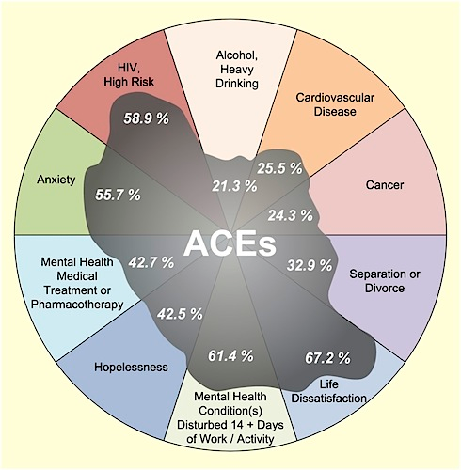
Population Attributable
Risk
The Attributable Risk indicates the number of cases of a disease among exposed individuals that can be attributed to that exposure
54% of depression
58% of suicide attempts
39% of ever smoking
26% of current smoking
65% of alcoholism
50% of drug abuse
78% of IV drug use
48% of promiscuity (≥ 50 sex ptnrs)

Slide 10
“Resilience is the process of adapting well in the face of adversity, trauma, tragedy, threats or significant sources of stress”
Characteristics of Resilient People
Healthy, supportive, caring relationships
The capacity to make realistic plans and take steps to carry them out.
A positive view of yourself and confidence in your strengths and abilities.
Skills in communication and problem solving.
The capacity to manage strong feelings and impulses.
Notes:
The American Psychiatric Association defines resilience as: “Resilience is the process of adapting well in the face of adversity, trauma, tragedy, threats or significant sources of stress” As we think about this definition some things stand out. There is a shift away from surviving a stressor to thriving with adversity. This is a strengths-based approach to thinking about resilience. It provides each of us with a map to increased resilience and well-being.
Most important to note, is this list of character traits is not complete. Resilient people show a lot of different qualities. There are definitely some that are more common; the belief in hope is important. Knowing that you will make it through your adversity is really critical.
Healthy, supportive relationships are key, in a bit my colleagues are going to dig deeper into the research of relationships and give you some resources and tools.
Let’s talk about Planning, when life gets really hard, it’s so important to go back to basic life skills. Supporting each other in making lists, utilizing reminders, and creating space for mistakes is fundamental when a major life stressor is present. Reminding ourselves that our brains have a limited capacity to process and focus when under duress is so important. We need to have some support mechanisms in place for those times of stress.
Communication and Problem Solving becomes even more important when someone is needing to grow more resilient. WE will dicuss that further in a few minutes.
Feelings and managing impulses are a part of growing socially and emotionally competent. These skills are also ones that you can learn and teach. We give you some concrete examples and ideas in the resources section.
Let’s move on to some skills we can begin to teach to increase resilience.

Slide 11
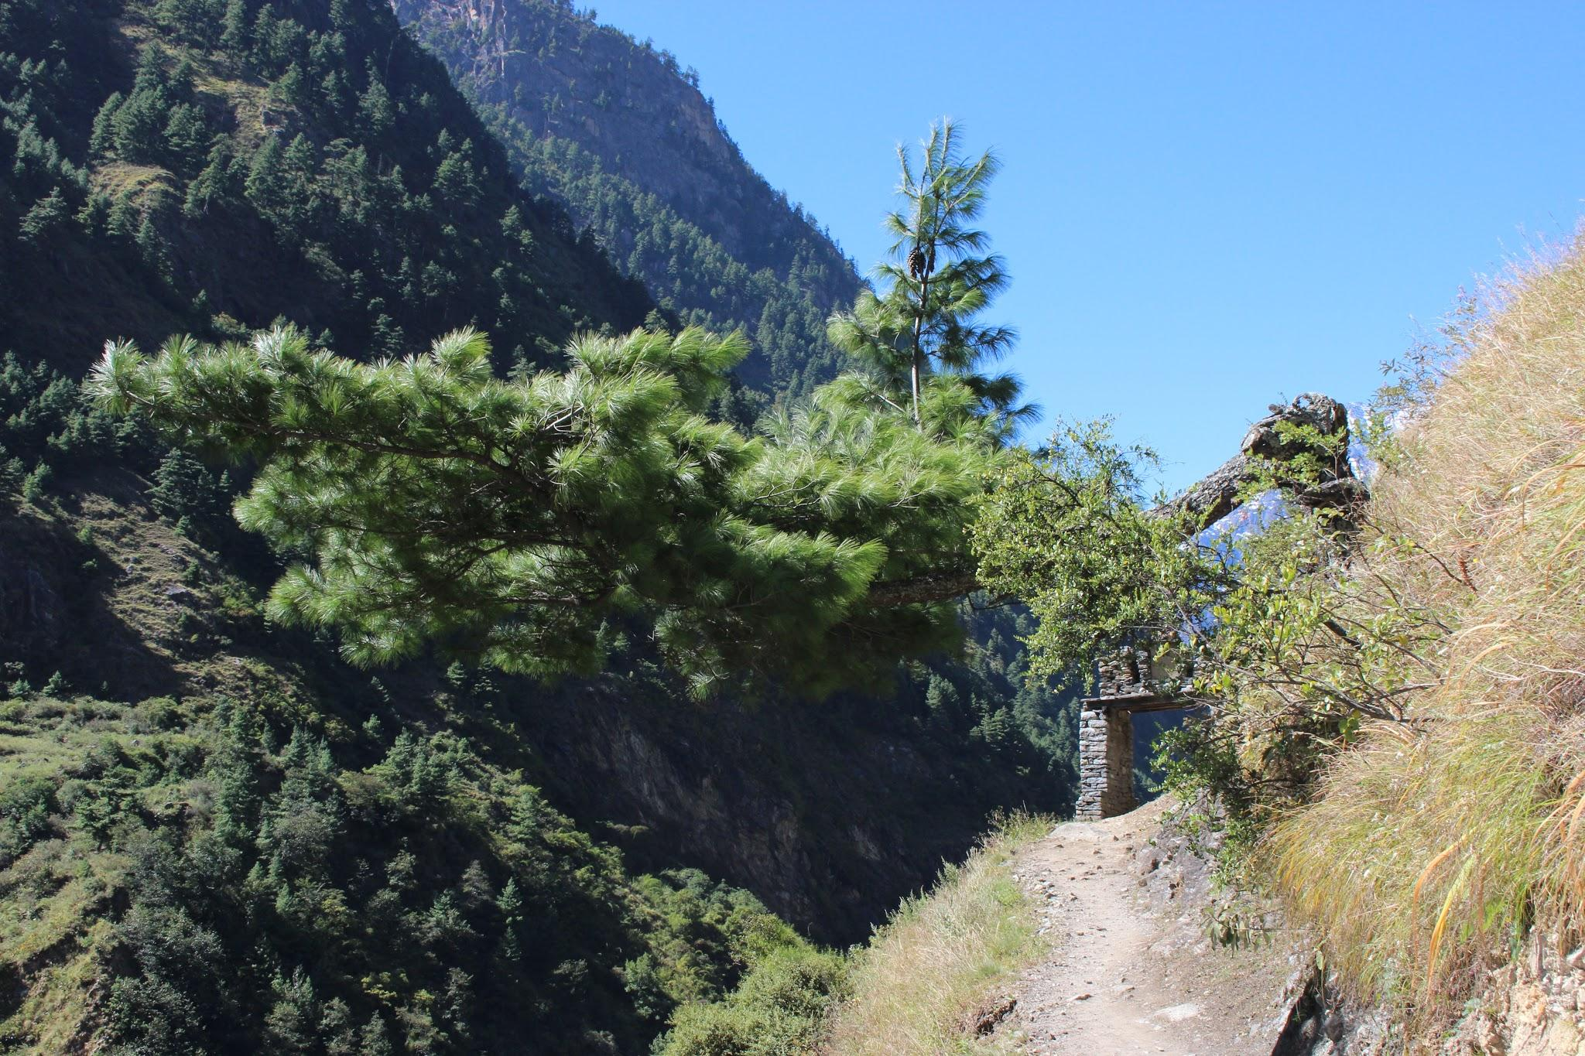
“Resilience in not an innate characteristic, it is a skill to be taught, learned, and practiced.”
-Jack Shonkoff, MD Harvard University
Notes:
Please take just a moment to ponder this quote…..GIVE them 30 seconds….I want you to jot down your thoughts on how this might be different than what you have been told about resilience….it’s incredibly hopeful to understand that resilience can be learned and grown. That no matter how difficult circumstances might become we can do something to weather the storm.

Slide 12
Resilience is much more than “Bouncing Back” from challenges and adversity. In describing findings from the ACEs study, Felitti (2002b) acknowledged:
“...One does not just ‘get over’ some things, not even fifty years later.”
Building resilience is helping people to
Successfully adapt despite current or past trauma and
Achieve personal growth and positive change
Intentional, and sometimes intensive, interventions are needed to help people learn to develop resilience
Source: Mary Sciaraffa, Ph.D. CFLE, Eastern Kentucky University
Notes:
Here is another perspective that comes out of the ACE research with Dr Felitti. We need to pay attention to the fact that the experiences in childhood make a lifelong impact on people. Our ability to create safe and compassionate interactions will build trust within people. That trust is a starting point to a safe and healthy way of responding to challenges. If we give people the opportunity to talk about their history we begin to support change and positive experiences. We can support people as they assess their strengths and identify areas of potential growth.
Let’s move on to some skills we can begin to teach to increase resilience.

Slide 13
Building the Skill of Resilience
Create opportunities for parents to create and maintain positive relationships.
Support parents as they build their problem-solving and planning skills.
Remind parents that they are the first and best person to buffer their child from stress.
Support parents as they build their stress management skills.
Notes:
This list is not comprehensive, it is a summary of the themes around resilience, relationships, self-care, stress management and life skills (Problem Solving and planning). Some stressors are going to happen to families that no amount of planning can prevent however, many of the additional burdens of that situation can be alleviated by healthy relationships and a plan in place. For example….teaching parents to rely upon reliable people for their concrete support network (child care, rides, advice) is so important. Many family systems begin to falter when they choose people who are not able to meet their needs. WE need to assist people in creating diverse and wide systems of support and we need to normalize asking for help. As we move on to the next section of our presentation, I want to leave you with the third bullet. parents are the first and best person to help their child become resilient. In order to care effectively for children, we need to look at and care of their caregivers with the same compassionate attention. I’ll turn this over to my colleague Liz who will be giving you some excellent examples of programming and research that will continue to support your efforts.

