Slide 1
2018 HCE WAHCE Conference
“Keep Your Credit Report in Check”
LEADER’S PLANNING GUIDE
This page (& notes below) is for the program leaders information only.
Notes:
Overview: This leader’s guide is to help HCE members understand the importance of periodically reviewing your free credit report several times each year and understanding how the information in your credit report impacts your credit score. It is designed to be delivered by HCE members in a group setting in approximately 45 minutes. It focuses on the basic understanding of credit reports and credit scores as well as the impact your score has on future lending, jobs and rental agreements.
Choosing an Audience: Who might be interested?
General public
HCE club or special interest group
Young Adults
Financial institutions
School personnel
Potential Partners - Your Family Living Educator will be an invaluable support as you decide how your county HCE program will use these resources. Talk over your plans with your HCE committee and your county’s Family Living Educator. To introduce these materials and help get the training arranged, a community partnership could be developed with individuals from the following:
Senior Citizen Groups
Community of Faith
Service Organizations
4-H, Local PTO’s or youth organizations
Schools
Presentation Type
One session
Learning sessions at Education Days sponsored by HCE
Supplies Needed
Name Tags
Pens and Pencils
Power Point presentation, computer, projector
Credit Score Pie Chart Matching - assembled - 1 per every 2-4 people
Sign In Sheet
Labels (optional) Avery 5163 and/or Avery 5160
Participant Handouts
Credit Score
Check Your Credit Report for Free (half sheet)
Credit Report Review Checklist
Reading a Sample Credit Report
Credit Reports & Scores Scavenger Hunt Activity Sheet with answer key (page 2)
Powerpoint Slides Note Page
Reminder labels (optional)
Advance Preparation
Review all materials
Print Materials (activities and handouts)
Assemble Credit Score Pie Chart Matching Activity
Set up computer and projector
Calendar Labels (optional)
Avery 5163 is the free credit report labels document.
Avery 5160 is the credit report reminder label document.
Directions: Teaching outline follows along with the master PowerPoint. This session should be taught with the PowerPoint slides provided either by showing the PowerPoint or providing a copy of the slides to the HCE members. The notes section of the slides provide more information for talking points, background information and website links for further learning.

Slide 2
Keep Your Credit Report in Check
Carol Bralich,Washington County
Amanda Kostman,Walworth County
Sept. 19, 2018 WAHCE Conference
Notes:
Hello!
Introduction of presenters
Logistics

Slide 3
Penny for Your Thoughts
Have you obtained your free credit report in the past year?
Have you ever pulled your free credit report?
Have you found mistakes on a credit report?
Notes:
Assess your audience’s experience with credit reports:
Ask the participants to stand up or raise your hand if the answer to the questions on the slide is yes.
Read each question and allow time for participants to answer.

Slide 4
Notes:
Clarify the differences between credit reports and score:
A credit report is a record of a consumer's credit history and serves as credit references. A credit score is an algorithm that measures your credit risk based on the information in your credit report at one point in time. Your credit score number is a reflection of the activity that is listed in your credit report. It is important to know the
information or reason behind the credit score so you are able to make changes to improve your score or correct any errors.
Credit scores are ok to know as a ballpark number where you are at, but also note that different lenders use different formulas to determine the score they use to determine your credit risk.
UW Extension resource: https://fyi.uwex.edu/creditreport/report_vs_score/

Slide 5
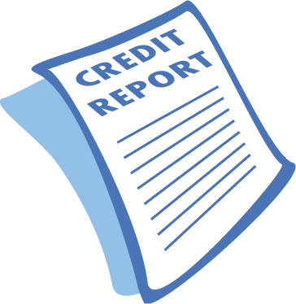
Checking Credit
Only 36% of adults check report annually (ORC International, 2018)
15.9 out of 200+ million consumers use AnnualCreditReport.com annually (CFPB, 2012)
5% of records have errors that could have negative consequence (FTC, 2013)
Notes:
Possible Talking Points with sources:
Over the past four years, even though the percentage recently obtaining their credit reports (versus their credit scores) in the past years has increased (from 29 percent in 2014 to 36 percent in 2018), the percentage who say it is important to check these reports has declined (from 72 percent in 2014 to 67 percent in 2018). - report was commissioned by CFA and VantageScore and undertaken by ORC International. https://consumerfed.org/press_release/survey-shows-an-increasing-number-of-consumers-have-obtained-their-credit-scores-and-know-much-more-about-credit-scores
Did you know that 18% of adults have never checked their credit score or report? https://money.cnn.com/2018/02/26/pf/credit-score-check-equifax/index.html
Who is most likely to check their credit report?
Millennials were the most likely generation to have checked their credit score and report in the last six months, the survey found. https://money.cnn.com/2018/02/26/pf/credit-score-check-equifax/index.html
The Consumer Financial Protection Bureau (CFPB) is a great consumer resource regarding credit, filing consumer complaints and other financial information. https://www.consumerfinance.gov/
In FTC Study, Five Percent of Consumers Had Errors on Their Credit Reports That Could Result in Less Favorable Terms for Loans https://www.ftc.gov/news-events/press-releases/2013/02/ftc-study-five-percent-consumers-had-errors-their-credit-reports

Slide 6
What is a Credit Report?
Your credit report is a detailed record of your credit history.
The credit report is used to calculate an individual’s credit score.
Notes:
Read Slide
We will talk more about the content of a credit report.

Slide 7
What’s in your credit report?
Identifying information
Bankruptcy
Credit accounts history
Inquiries
Optional consumer statement
Directions to correct errors
Notes:
What’s in your credit report?
Identifying information - The PERSONAL CONSUMER INFORMATION includes your full name, as well as current and past addresses. This data comes from the information given to creditors. TIP: Make sure this information is correct. A wrong address or phone number could be a mistake – or a sign of identity theft. See handout: “Reading a Sample Credit Report” for more information
PUBLIC RECORDS INFORMATION is data collected from court records and is viewed negatively by lenders. This section includes bankruptcies. Other public records for civil judgments and tax liens have recently been removed from credit reports as of April 2018, but could appear in other types of reports. NOTE: A bankruptcy can stay on a credit report for 7-10 years from the date of filing depending on the type of bankruptcy. Chapter 7 bankruptcy is reported for 10 years since all debt is discharged. Chapter 10 bankruptcy is reported for 7 years since some of the debt is paid back. See handout: “Reading a Sample Credit Report” for more information
Credit accounts history- See handout: “Reading a Sample Credit Report” for more information
ADVERSE ACCOUNTS show lines of credit that have not been paid, have missed or late payments, were sent to a collection agency, or were “charged off” meaning that the company reported the debt as lost income and may have sold the debt to a collection agency. A history of late payments lowers your credit score, especially if it’s more recent. Many lenders will not offer credit until overdue debts have been paid. TIP: Negative items can legally be removed from a credit report if it’s been more than 7 years from the date the debt first became overdue. If old items are listed, contact the credit bureau and ask these accounts to be taken off.
The SATISFACTORY ACCOUNTS section shows credit accounts that are current or have been paid as agreed. The accounts listed are from information reported by lenders. Creditors choose whether to report account information to none, one, two, or all three of the major Credit Reporting Agencies and how often to report. Having satisfactory accounts that you pay the balance on regularly is good for your credit score.
The ‘Account Type’ lists the kind of credit account.
Installment Accounts – like car or student loans where you borrow a set amount and then make monthly payments.
Revolving Accounts – usually credit cards that have a credit limit.
Inquiries - The CREDIT INQUIRIES section includes information about when a credit report has been requested. There are two types of inquiries:
REGULAR INQUIRIES are also known as HARD inquiries. When you apply for credit or buy insurance, for example, the lender reviews your credit report for a positive history and credit worthiness. These inquiries stay on a report for 2 years and can be seen by all creditors who look up your report. Hard inquiries can drop a credit score by 5-20 points for many months.
ACCOUNT REVIEW inquiries are also called SOFT or Promotional inquiries. Companies ask for certain parts of your credit information to see if you qualify for their services. These items are only seen by you and do not affect your credit score.
See handout: “Reading a Sample Credit Report” for more information
Optional consumer statement - This is not used very often but is tool available to you. You can add information pertaining to a specific account or a general statement. For more information see https://www.experian.com/blogs/ask-experian/be-cautious-about-adding-statements-to-your-credit-history/
Directions to correct errors will be discussed later in presentation.

Slide 8
What’s NOT in your credit report?
Criminal background
Race, gender, religion, national origin
Medical information
Buying habits / transaction data
Bank account information
Evictions
Notes:
Credit reports also do not contain:
Checking or savings account balances
Income
Medical history
Purchases made with cash or checks
Business account information
Driving record

Slide 9
How long can information stay on a credit report?
Open accounts in good standing: indefinitely
Closed accounts in good standing: usually 10 years
Late or missed payments: 7 years
Bankruptcy:
Chapter 7: 10 years
Chapter 13: 7 years
Credit inquiries: 2 years
But a few exceptions exist!
Notes:
For more background information:
Here is a list of how long the most common items remain in a credit report:
Open, positive accounts: indefinitely
Closed, positive accounts with no negative history: 10 years from closed date
Late payments: 7 years from the original delinquency date
Chapter 7 bankruptcy: 10 years from the filing date
Chapter 13 bankruptcy: 7 years from the filing date
Tax liens: 7 years from the filing date if they are paid, 10 years from filing date if unpaid.
Credit inquiries occur when your credit report is accessed. Only hard inquiries affect your credit score.
https://www.experian.com/blogs/ask-experian/how-long-can-negative-items-stay-on-your-credit-report/
For more information see How Long Does Something Stay on My Credit Report? and Credit Report Details.

Slide 10
Why Check Your Credit Report?
The information on your credit report can effect:
Amount of interest for credit cards/loans
Monthly insurance
Ability to get a mortgage or apartment
Application for some jobs
Your report contains detailed credit activity for the last 7-10 years
Creditors, insurers , employers and landlords use the report!
Notes:
Read Slide

Slide 11
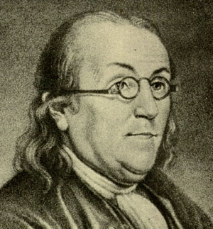
“Creditors have better memories than debtors.” ~Benjamin Franklin

Slide 12
Fair Credit Reporting Act and Fair & Accurate Credit Transactions Act
Fair Credit Reporting Act (FCRA) Act passed in 1970 by Congress
Fair and Accurate Credit Transactions Act of 2003 (FACTA) Act passed in 2003 by Congress
Americans are entitled to one free credit report per year from each of the 3 credit bureaus
Can anyone name the 3 credit bureaus?
Notes:
The Fair Credit Reporting Act (FCRA) is a federal law that regulates credit reporting agencies and compels them to insure the information they gather and distribute is a fair and accurate summary of a consumer’s credit history.
The FCRA is chiefly concerned with the way credit reporting agencies use the information they receive regarding your credit history. The law is intended to protect consumers from misinformation being used against them.
The 3 credit bureaus are Experian, Equifax and TransUnion.
Additional background information:
It offers very specific guidelines on the methods credit reporting agencies use to collect and verify information and outlines reasons that information can be released. The Fair and Accurate Credit Transactions Act of 2003 (FACTA) is a federal consumer-rights law that amended the Fair Credit Reporting Act of 1970 (FCRA). Its primary purpose is to reduce the risk of identity theft by regulating how consumer account information (such as Social Security numbers) is handled.
http://www.acc.com/legalresources/quickcounsel/tfaacta.cfm
Under the Fair Credit Reporting Act, you have a right to:
Access to Your Credit Report – The act requires credit reporting agencies to provide you with any information in your credit file upon request once a year. You must have proper identification. You have a right to a free copy of your credit report within 15 days of your request.
Protected Access – The act limits access to your file to those with a valid need. That would usually be banks, insurance companies, employers, landlords or others doing business that involves offering credit. You also have the right to know who has requested your credit report in the last year or, for employment-related requests, two years.
Accurate Reporting – If inaccurate information is discovered in your file, the consumer reporting agency must examine the disputed information, usually within 30 days. If the inaccurate information cannot be verified, the consumer reporting agency has a responsibility to remove it. If you are not able to clear up the matter, you are allowed to add a statement to your credit file explaining the situation.
Have Outdated Information Removed – Negative information must be removed from your file after seven years. Bankruptcy, however, may remain on record for 10 years, and criminal record information can remain indefinitely.
Maintain Medical Information Privacy – You are protected from having medical information in a consumer report, as creditors are prohibited from obtaining or using medical information when making a credit decision.
Limit Unsolicited Credit Offers – The law allows you to request to have your name and address removed from unsolicited prescreened offer lists for credit and insurance. To opt out of such correspondence, call (888) 5-OPTOUT (888-567-8688).
Protect Your Personal Account Numbers – Businesses are not permitted to publish full credit card numbers on receipts. The law also allows you to protect your Social Security number by having it truncated on your credit report.
Receive Notification of Possible Negative Information – You have the right to be notified if any financial institution submits, or plans to submit, negative information to a credit reporting agency. This information may be included in a billing statement or a notice of default.
Seek Damages – You have the right to sue and seek damages in a state or federal court from anyone, such as a consumer reporting agency or a user of consumer reports, who violates the Fair Credit Reporting Act.
Know When Your Credit Report Is Used Against You – If you are denied credit, insurance or employment because of your credit report, you can ask for the specific reason for the denial.
Know Your Credit Scores – You have a unique credit score with each credit bureau, which you can request. In some cases, you may be required to pay for this information.
https://www.debt.org/credit/your-consumer-rights/fair-credit-reporting-act/

Slide 13
Check Your Report 3X per year!
Check your report 3 times a year on
February 2nd (2/2): Equifax
June 6th (6/6) Experian
October 10th (10/10) TransUnion
Easy to remember set of dates
Helps prevent problems. You cannot check your report with same bureau within 365 days
Visit http://fyi.uwex.edu/creditreport/ and sign up for email reminders!
Notes:
Point out the reminder cards with the dates and website.
Refer to stickers templates given that can be distributed at the session to be put on calendars.
Could set a reminder in your Outlook calendar

Slide 14
Have you tried to get your credit report in the past and had problems?
Notes:
Ask audience this question to see if anyone has experienced issues trying to obtain their free credit report by show of hands.
Discussion if needed.
Proceed with slide 15 to give more direction and tips on obtaining reports.

Slide 15
How to Obtain Your Free Credit Report
Annual Credit Report Request Service
PO Box 105281
Atlanta GA 30348-5281
www.annualcreditreport.com 1-877-322-8228
Notes:
Refer to the “Credit Report Review Checklist” handout gray box at the bottom for details and the 2018 free credit report date info half-page.
There are 3 different ways to access your free credit report once per year from each credit bureau by request: Mail, online and phone call.
Copy of request form for mailing located here: https://fyi.uwex.edu/creditreport/obtaining_your_report/#obtain

Slide 16
Information Needed
Full Name
Social Security Number or Individual Taxpayer Identification Number (ITIN). If using an ITIN, you must mail a request form
Date of Birth
Address
Previous addresses from the past two years. We recommend having this information ready before starting and not relying on memory if you have moved several times. Entering wrong addresses can delay the process.
Notes:
Request form: https://fyi.uwex.edu/creditreport/obtaining_your_report/#obtain

Slide 17
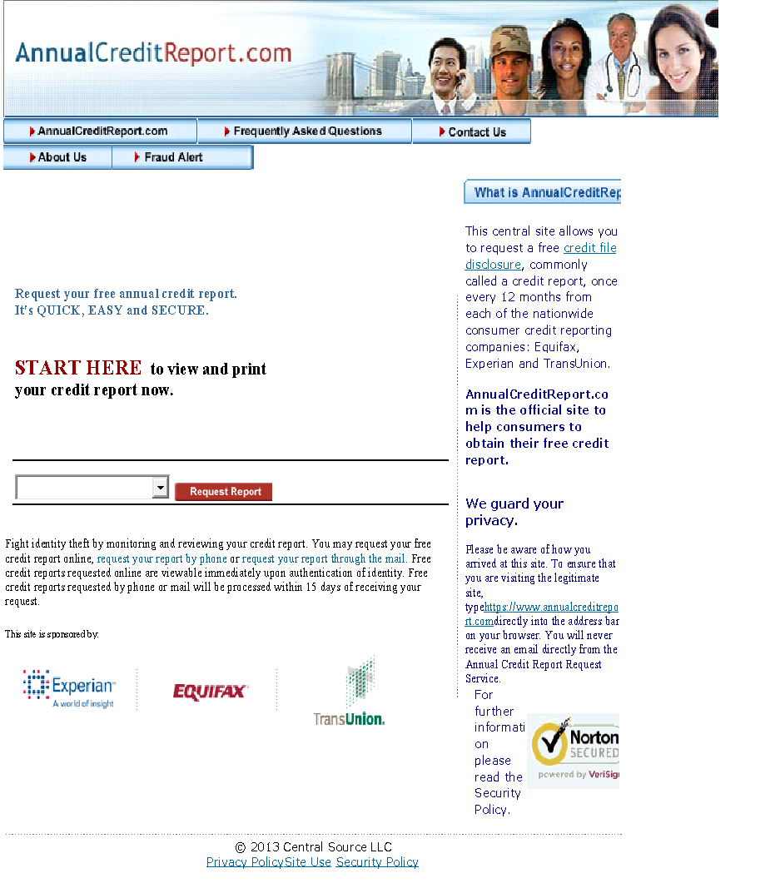
Logging In
State of residence
Past address if < 2 years
Image with letters: e.g. “LGHA7Y”All CAPs
Pick A Bureau
Can only do each one once every 12 months
Notes:
If you choose to request your credit report online, go to http://www.annualcreditreport.com/ . This slide shows what you will see when you go to the website and what information you will need to enter. You may also be asked verification questions.
Here is a 5 minute tutorial video by J. Michael Collins, Center for Financial Security, to guide you through the online process of checking your free credit report: https://fyi.uwex.edu/creditreport/files/2013/01/Credit_report.mp4

Slide 18
Key Information
Equifax, Experian, and TransUnion each have different authentication process. You may have trouble accessing one but not others.
You should NEVER be asked to enter a credit card number.
You can print a copy of your report or return to the site within 30 days to review it again.
Can also call 1-877-322-8228 or submit a request by mail.
Equifax P.O. Box 740256 Atlanta, Georgia 30374 1-877-576-5734
Experian P.O. Box 9554 Allen, Texas 75013 1-888-397-3742
TransUnion P.O. Box 6790 Fullerton, CA 92834
1-800-680-7289
Notes:
Review the slide.

Slide 19
What to do with your Credit Report?
Go through each line carefully! Are there
Any accounts that you do not recognize
Accounts that have inaccurate payment status
Accounts that have incorrect amounts listed
Creditors that you don’t recognize
If you spot an error contact both the credit bureau and creditor to dispute the information.
Each credit bureau has a different process
Dispute mistakes by mail to start a paper trail
Notes:
Ask participants to pull out the “Credit Report Review Checklist” handout.
See https://fyi.uwex.edu/creditreport/reading/ for more information on reading a report and https://fyi.uwex.edu/creditreport/fixing_errors/ to fix reports from UW Extension Specialists

Slide 20
Notes:
It helps to have a paper trail started with the credit bureau if you have a dispute with the information in the report. If you talk with someone on the phone, be sure to get that person’s name and direct phone number, and record the date and time of phone conversation.

Slide 21
Scavenger Hunt Activity
Review sample credit report
Answer questions on scavenger hunt worksheet at your table
Discuss answers
Notes:
15 minutes
Materials needed:
Sample credit report handout
Scavenger hunt worksheet
Answer sheet
Directions: As a review of material presented thus far, have participants answer the questions on the Scavenger Hunt worksheet using the “Reading a Sample Credit Report” handout. Time: Allow 7-10 minutes for participants to answer questions. Review answers together.

Slide 22
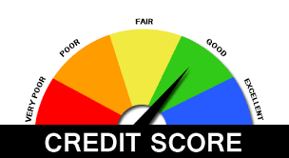
Credit Score
Notes:
We are now going to focus more on credit scores.

Slide 23
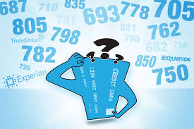
What is a good score?
The national average is 678.
Range is 300-850:
850-780: Low Risk
780-740: Medium- Low Risk
740-690: Medium Risk
690-620: Medium – High Risk
Below 620: High Risk (sub-prime)
Notes:
Many credit scores referenced, use the FICO score which is based on models developed by the Fair Isaac Corporation.
The models begin with information on your report, using it to calculate your score.
Scores range from 300-850.
The majority are between 600 and 800.
They vary from one credit bureau to another.
Visit www.myfico.com/ScoreEstimator.html to get an estimate of your score. In addition, many financial institutions and credit card companies are offering to provide your credit score for free on monthly statements.
Note: Not all lenders, credit bureaus, credit card companies use the same formula to calculate your credit score, so you might see a slight difference.
UW Extension resource: https://fyi.uwex.edu/creditreport/report_vs_score/#score

Slide 24
What does my credit score mean?
A good credit score doesn’t just mean that you’ll get a loan, it also means you’ll pay less for it.
A low FICO score may result in a credit card rate twice that of a high FICO score.
Notes:
Using the FICO Score Pie Chart Matching Activity Materials, ask participants to match the green category box with the corresponding the gold category definition box and then them on the pie square that they believe would reflect the percentage that piece of data would make up that their FICO score.
Go to next slide for the answers to the activity.
Refer to the “Credit Scores” Handout for more information or is available here: https://fyi.uwex.edu/creditreport/files/2018/05/Credit-Scores-handout-5.18.pdf

Slide 25
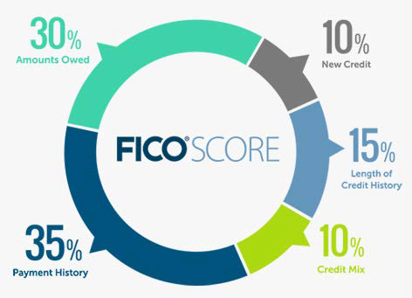
What affects your credit score?
Source: Fair Isaac Corporation, www.myfico.com, retrieved 2018.
Notes:
Factors That Determine Your Score
The following information is based largely on “What’s in My FICO® Scores”:
http://www.myfico.com/CreditEducation/WhatsInYourScore.aspx
Payment History—35%
Have you paid your debts on time? That’s what lenders want to know, so payment history is the biggest part of your FICO® score. If you have a strong overall credit history, one or two late payments may not hurt your score very much. Your score will increase if most of your accounts show that you have made all payments on time (“paid as agreed”).
FICO® looks at your payment record for different types of accounts, including:
Credit cards, including bank and major credit cards such as Visa, Master Card, Discover, and American Express.
Store or retail accounts, such as department store credit cards.
Installment loans where you make regular, fixed payments, such as car loans and student loans.
Finance company loans, which are typically used by individuals who cannot get a loan from a bank or credit union. These are often small loans and usually have higher interest rates than bank loans.
Mortgages.
How much late payments hurt your FICO® score depends on the details:
How late were they?
How much did you owe?
How recently were you late?
How many times were you late?
Amounts Owed and your available credit—30%
A credit report does not include your income, so a credit scoring company cannot compare the amount of debt you have to your income. Instead, they use other signs to figure out whether you will be able to manage your debt.
FICO® looks at these items to decide whether you might be over-extended:
The number of accounts on which you owe money: The more accounts with balances, the more likely the credit scoring company will think that you have too much debt.
The total you owe on all your accounts: The more you owe, the more likely it is that you are overextended.
Owing money on certain types of accounts, like credit cards and installment accounts.
Installment loans on which you still owe most of the original loan amount.
“Maxing out” your credit cards: Divide your credit limit by your balance to find your utilization ratio. For example, if you have a balance of $800 on a credit card with a limit of $1,000, your utilization ratio is 80%. The ratio is calculated both for individual cards and for all your cards together. The more cards you have with high utilization ratios, the more likely the credit scoring company will think that you have more debt than you can manage.
Closing accounts that you have paid in full and on which you have a good payment history will not improve your credit score.
Even if you pay your credit card balance in full each month, your credit report will likely show a balance because the credit card will probably report the balance from your last statement.
Regular payments on an account, even if the charges are small, may help your score more than having no account activity.
Length of Credit History—15%
The longer your credit history is, the better your FICO® score. But someone with a short credit history can still have a high score if the rest of their credit information is strong.
FICO® says that it looks at length of credit history in a variety of ways, including:
How long your accounts have been open, including their average age and the ages of your oldest and newest accounts.
How long specific credit accounts have been open.
How recently you used certain accounts.
Opening new accounts can hurt your credit score by lowering your average account age.
New Credit—10%
A FICO® score considers several factors about new accounts and applications for credit.
How many new accounts do you have?
Fewer or none is better.
What types of accounts are they? For example, are they all credit cards?
How many of your accounts are new (less than six months old)?
Opening more than one account in a short period of time can hurt your credit score, especially if you have limited credit history.
Even if you have a long credit history, opening a new account can lower your credit score.
How long has it been since you opened a new account?
Longer is better.
How many recent inquiries are on your credit history?
This refers to inquiries you initiated by applying for credit. This includes applying for a store credit card to get the discount, a car loan, overdraft protection at the bank, etc. An inquiry stays on your credit report for two years but the scoring process usually only considers inquiries in the last 12 months.
Many types of inquiries have no impact on your credit score. For example, promotional inquiries or offers to lend you credit that you did not ask for, current accounts that periodically check your credit, and pulling your own credit report do not count against you.
Inquiries usually have a small impact, but several recent inquiries within a short time may multiply that impact. For example, you might have applied for a car loan, opened a bank account with overdraft protection, and gotten instant credit at a store where you shop, all within a few months.
Multiple inquiries within a short period of time that are all from car dealers or from mortgage companies may be treated as a single inquiry; the credit scoring company recognizes that you may be shopping around and will only buy one car or take out one mortgage. The inquiries need to be within a certain time period—from two weeks to 45 days—depending on the version of FICO® being used by the lender.
Types of Credit—10%
Having a mix of different types of credit accounts may help your score, while having only credit cards or finance company accounts can hurt. The types of credit you have may be more important if there isn’t much information in your credit history.
The Types of Credit part of your FICO® score looks at the same types of accounts as the Payment History component:
Credit cards.
Store or retail accounts.
Installment loans.
Finance company accounts.
Mortgages.
Having both an installment loan and a credit card that you pay on time can help your score. People with a credit card may have a higher score than people without one. But you don’t need to have all these types of accounts, and too many accounts may hurt your score. Knowing how many accounts is too many may be difficult to determine, however, since it will vary based on the other information in your credit report.
Finance company accounts typically lend money to high-risk borrowers. As a result, credit scoring companies do not view them as “positively” as a traditional bank loan or credit card account. When paid on time, they will still help build a positive credit history, but they may not carry as much weight as a positive payment history on other types of accounts.

Slide 26
Improve Your Score
Pay bills on time
Check credit reports for accuracy
Pay down credit card balances
Keep older accounts open; avoid opening new ones
Improve your credit habits
Be patient, it will be a gradual improvement.
Notes:
Read slide

Slide 27
Signs that you have more expenses than income:
Behind on bills.
Carry a credit card balance.
Spending money for interest and late fees.
Not able to save for future purchases.
Increase in money arguments.
Lost sleep.
Notes:
If you are seeing any of these signs, start thinking about ways to increase your income, decrease your spending or both. Think about ways to make things last longer.

Slide 28
Catching up on credit payments:
Try not to take on any new debts.
Make a list of all your debts.
Figure out how much money you can pay towards debt.
If you have money for payments - Use “PowerPay”
Notes:
Options to pay off debt – if people have money to put towards payments. Some people may not have additional money to pay off debt and may want to seek credit counseling to explore other options.

Slide 29
Power Pay Strategy
 | Discover | MasterCard | Doctor
April | $22 | $35 | $35
May | $22 | $35 | $35
June | $57 | $35 | $0
July | $57 | $35 | ---
August | $57 | $35 | ---
September | $0 | $92 | ---
October | --- | $57 | $35
…and so on | --- | $92 | $0
Notes:
One strategy: Power Pay Strategy
Walk through example.
In this example, this person is able to pay a monthly payment for all three bills: Discover, Mastercard and the doctor. By the end of June, the doctor bill is paid off. Therefore, they are able to apply that $35 toward the Discover bill to pay off a higher amount. In August, the Discover bill is paid off, which then allows a larger payment for the Mastercard (35 + 57). In October, another doctor bill comes along, so the Mastercard payment lessons, but is still more than back in April.
Key idea: By applying the extra money leftover from a fully paid bill, you are speeding up the pace to pay off the next bill. And, most likely you won’t miss that amount of money because it was used to pay a different bill in the past.

Slide 30
But what if there’s not enough money?
Spending
Income
Notes:
If you don’t have money for minimum payments:
Talking with creditor – always first option!
Financial counseling or coaching through CCCS or UWEX
Debt management – can lower total debt but still need money for payment plan
Debt consolidation – beware – lots of scams out there!
Bankruptcy – last resort, need to talk with attorney and go through $ counseling

Slide 31
When you can’t pay bills . . .
Start now!
Notes:
Check with your Family Living Educator for a handout or list with local resources.
Kind of a downer to end – so instill a ray of hope!
Work on a little at a time, budget creation, track spending, work with spouse
Quiz: http://www.creditscorequiz.org/CreditScoreQuiz_AnswerKey_Eng.pdf
http://www.creditscorequiz.org

Slide 32
Obtain your free credit report
Review Credit Report for common errors
Make an action plan!
Write to credit bureau about errors
Make payment plan for past due debts
Obtain help from Consumer Credit Counseling
Notes:
To get you started….we have a challenge for you!
Obtain your free credit report from one of the Credit Bureaus within the next few weeks if you have not done so recently.
Encourage one other family member or friend to do so as well.

Slide 33
Thank You!
Notes:
Ask for any final thoughts, questions or ahhh haaa moments.
Distribute and collect evaluations.
Thank them for coming.

