Slide 1
Stress
& Resilience
Presented by: Mandi Dornfeld and Tenley Koehler
2019 WAHCE State Conference

Slide 2
That’s Me!
You are at an HCE event
You would like a million dollars
You enjoy scary movies
You’ve traveled in the last month
You have more than 2 siblings
This is your first time at the State Conference
You know the person next to you (Quick say hello!)
You have felt stressed in the last month...
Notes:
Optional warm-up: Read the statements one at a time. Tell the group to raise their hand and shout “That’s me!” if the statement rings true for them.

Slide 3
Let’s Talk Stress
Positive Stress
Tolerable Stress
Toxic Stress
Notes:
Yes, we’ve all experienced stress in some form. But let’s spend a moment talking about stress what stress is and what stress isn’t.
First of all, Not all stress is bad. In fact stress can be a great motivator. For instance, stress can motivate us to move on, ask for help, or try something new.
We can experience, Positive stress like a new job, birth of a child or grandchild, or joining a new exercise group. These stressors may elicit our brains and bodies to respond. Our brains might send us stress hormones that flood our body and prepare us for action. That’s the feeling like there is a lump in your throat or a weight on your chest. What signs does your body give you to tell you there is stress in your life?
Another kind of stress is called Tolerable stress. These stressors tend to be more serious- loss of a job, divorce, financial difficulty- but in the presence of a supportive relationship can be tolerated and overcome.
Then there is toxic stress which if left unaddressed can be detrimental to our health and wellbeing. In the presence of stress, resilience is our lifesaver.
https://developingchild.harvard.edu/science/key-concepts/toxic-stress/

Slide 4
“Resilience in not an innate characteristic, it is a skill to be taught, learned, and practiced.”
-Jack Shonkoff, MD Harvard University
Notes:
Please take just a moment to ponder this quote…..GIVE them 30 seconds….I want you to jot down your thoughts on how this might be different than what you have been told about resilience….it’s incredibly hopeful to understand that resilience can be learned and grown. That no matter how difficult circumstances might become we can do something to weather the storm.

Slide 5
“Resilience is the process of adapting well in the face of adversity, trauma, tragedy, threats or significant sources of stress”
Notes:
The American Psychiatric Association defines resilience as: “Resilience is the process of adapting well in the face of adversity, trauma, tragedy, threats or significant sources of stress” As we think about this definition some things stand out. There is a shift away from surviving a stressor to thriving with adversity. This is a strengths-based approach to thinking about resilience. It provides each of us with a map to increased resilience and well-being.
Most important to note, is this list of character traits is not complete. Resilient people show a lot of different qualities. There are definitely some that are more common; the belief in hope is important. Knowing that you will make it through your adversity is really critical.

Slide 6
Characteristics of Resilient People
Healthy, supportive, caring relationships
The capacity to make realistic plans and take steps to carry them out.
A positive view of yourself and confidence in your strengths and abilities.
Skills in communication and problem solving.
The capacity to manage strong feelings and impulses.
Notes:
Healthy, supportive relationships are key, in a bit my colleagues are going to dig deeper into the research of relationships and give you some resources and tools.
Let’s talk about Planning, when life gets really hard, it’s so important to go back to basic life skills. Supporting each other in making lists, utilizing reminders, and creating space for mistakes is fundamental when a major life stressor is present. Reminding ourselves that our brains have a limited capacity to process and focus when under duress is so important. We need to have some support mechanisms in place for those times of stress.
Communication and Problem Solving becomes even more important when someone is needing to grow more resilient. WE will dicuss that further in a few minutes.
Feelings and managing impulses are a part of growing socially and emotionally competent. These skills are also ones that you can learn and teach. We give you some concrete examples and ideas in the resources section.

Slide 7
Resilience is much more than “Bouncing Back”
In describing findings from the ACEs study, Felitti (2002b) acknowledged:
“...One does not just ‘get over’ some things,
not even fifty years later.”
Notes:
Here is another perspective that comes out of the ACE research with Dr Felitti. We need to pay attention to the fact that the experiences in childhood make a lifelong impact on people. Our ability to create safe and compassionate interactions will build trust within people. That trust is a starting point to a safe and healthy way of responding to challenges. If we give people the opportunity to talk about their history we begin to support change and positive experiences. We can support people as they assess their strengths and identify areas of potential growth.
Let’s move on to some skills we can begin to teach to increase resilience.

Slide 8
Building resilience is helping people to:
Successfully adapt despite current or past trauma and
Achieve personal growth and positive change
Intentional, and sometimes intensive, interventions are needed to help people learn to develop resilience
Source: Mary Sciaraffa, Ph.D. CFLE, Eastern Kentucky University
Notes:
Here is another perspective that comes out of the ACE research with Dr Felitti. We need to pay attention to the fact that the experiences in childhood make a lifelong impact on people. Our ability to create safe and compassionate interactions will build trust within people. That trust is a starting point to a safe and healthy way of responding to challenges. If we give people the opportunity to talk about their history we begin to support change and positive experiences. We can support people as they assess their strengths and identify areas of potential growth.
Let’s move on to some skills we can begin to teach to increase resilience.

Slide 9
Motivational Speaker Jim Rohn said:
“You are the average of the five people you spend the most time with.”
Notes:
Dr. Brene Brown says we are born “wired for connection” and claims that connection is a basic human need for survival. The resilience research backs this up.
“Good relationships with close family members, friends, or others are important. Accepting help and support from those who care about you and will listen to you strengthens resilience. Some people find that being active in civic groups, faith based organizations, or other local groups provides social support and can help with reclaiming hope. Assisting others in their time of need also can benefit the helper.”
Have participants take a moment to answer the questions on the “Choosing Friends” handout then briefly reflect in large group.
Excerpt from: “The Road to Resilience” American Psychological Association apa.org/helpcenter/road-resilience.aspx
2017 Brene Brown LLC brenebrown.com

Slide 10
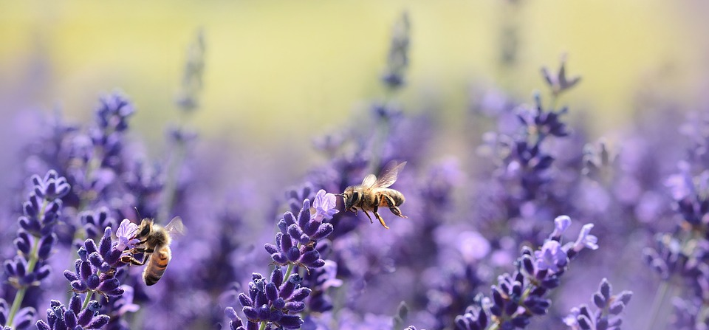
Problems-
We’ve Got Problems
Notes:
The ability to solve problems increases resilience. When we feel empowered to tackle our problems, we feel more prepared to meet life’s challenges. Problem solving is not a skill that we are born with and many of us have not had the opportunity to learn a specific strategy to identify and solve problems. Using the handout, let’s work through this process and see if you can come to a best solution.

Slide 11
Recasting
Find your feelings: - Sadness, fear, anger, joy
Find meaning in our feelings
Recognize opportunities
Notes:
Recasting: Dealing with things in life you can’t change
Sometimes life throws you issues that you can’t change. Remember this strategy as one way to help you work through the situation and use the situation to your advantage. First, take time to really feel your feelings. Try to identify them.
Remember the four basic feelings: sadness, fear, anger and joy. When you are ready, search for meaning in your feelings and ask yourself the following questions.

Slide 12
Find Meaning
What are the causes of the problem? – What was out of my control, and
what was in my control?
2. What could I have done differently?
3. What are my feelings or instincts
telling me?
4. What can I learn from this?
Notes:
Review the four questions. Finally, look for opportunities as a result of the situation, based on what you’ve learned.

Slide 13
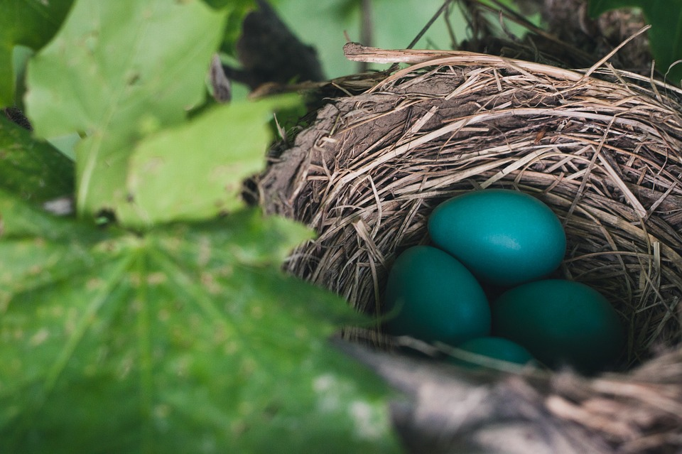
Goals that are S.M.A.R.T
S-pecific
M-easurable
A-ttainable
R-elevant
T-ime-Bound
Notes:
Goals that have no plan attached to them end up being wishes or dreams. It’s important to set and evaluate a goal so that you can feel prepared to meet them. It’s empowering to look at your goals and realize what is possible and what you might need to work on more.

Slide 14
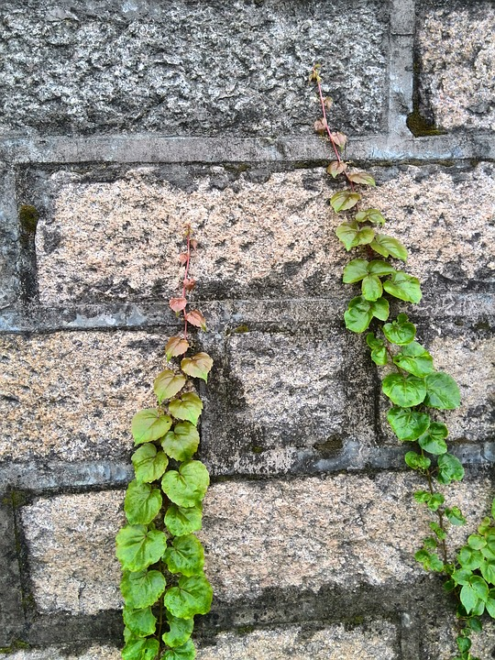
FACE your challenges
F-ind your target
A-ction steps needed
C-oping list
E-valuate how it went
Notes:
Still, challenges can oftentimes seem too overwhelming or maybe too delicate to face. In light of these challenges, some of us tend to ruminate, avoid, or wear masks of perfection instead of handling the situation.
Some other masks might look like:
Acting like everything is fine when it isn’t.
Saying you don’t care about something when you really do.
Pretending to be super nice when you’re really angry inside.
Acting angry when what you really feel is hurt.
These thoughts and these masks can get in the way of facing challenges head on and taking decisive action. Rather than detaching or hiding, focus on your target, write down some actionable steps, be prepared to cope, and then evaluate how it went. This creates a learning environment instead of a worry environment.
You can also try the following:
Stop- I will stop myself from...
Think- I will tell myself...
Do- What I’ll do instead
www.get.gg/face.htm © Carol Vivyan 2016.

Slide 15
Getting to Know Yourself
Opportunities for Self-Discovery
Notes:
Learning about what your hopes, dreams and motivations are is a powerful way to build resilience. When we know what makes our spirits sing.
Utilizing the handouts, My Joy List, Values to spend some time thinking about your life

Slide 16
Meditation and Self-Compassion
“May I be filled with loving-kindness
May I be happy
May I be healthy
May I be peaceful and at ease”
Notes:
In light of stress and challenge, one thing that many people neglect is care and compassion for themselves. The cliche exists for a reason “we cannot pour from an empty cup” nor should we pressure ourselves to do so. In order to give to others, we must first and foremost give kindness to ourselves. One way to help us do this is by practicing loving-kindness meditation.
See handout. Do together and reflect as a group.
Scientists have found that practicing loving-kindness, like we just did together, wires our brains for empathy and altruism. People who practice this meditation are more likely to experience positive feelings in response to a goal and are better equipped to regulate their emotions.
http://ggia.berkley.edu/practice/compassion_meditation

Slide 17
Feeling overwhelmed?
Remember “RAIN”
R-recognize what’s going on
A-allow the experience to just be there, as it is
I- investigate with kindness
N-natural awareness by not identifying with the experience
Notes:
Our thoughts can work for us and unfortunately, they can sometimes work against us too. It can be good practice to ask ourselves if what we are thinking is really true. Watch for traps like “everybody” “always” and “never.”
In the book Uncovering Happiness by Elisha Goldstein, Ph.D we learn that when we put space between ourselves and our reactions it can change our relationship with our thoughts and self-beliefs.
First ask yourself, “Is this thought true?”
Then ask yourself, “Okay, but is it really true?”
Next, notice how it makes you feel and name the feeling.
Lastly, imagine what it would be like if you didn’t hold this belief.
Another way to fact-check our thoughts is by remembering RAIN.
Go over RAIN handouts together.
Handout from Taking Care of You “Find Shades of Grey”

Slide 18
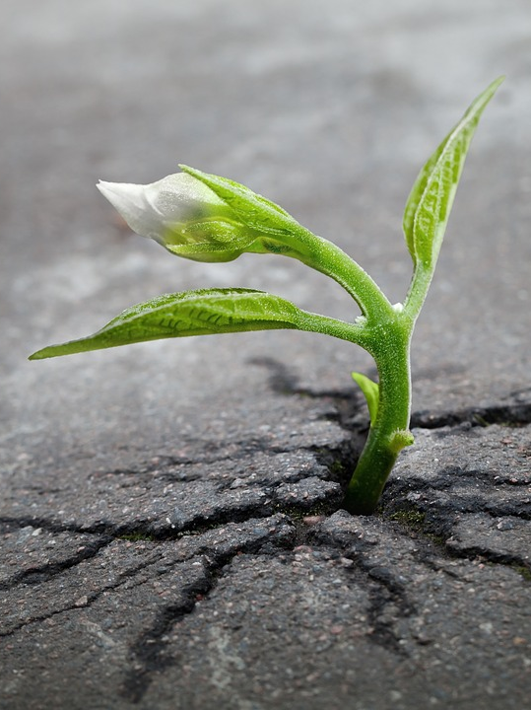
Hopefulness
“Hope is the thing with feathers that perches in the soul - and sings the tunes without the words - and never stops at all.”
-Emily Dickinson
Notes:
Review Hopeful Options handout.

Slide 19
Self-Care
Notes:
Let’s brainstorm some self care ideas.
Using this list or some of your own ideas, fill out the “At the end of this program” handout.
Have your participants write themselves a letter that you will mail to them in 30-60 days.

Slide 20
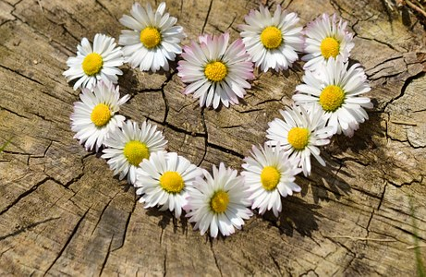
With Thanks
Notes:
What questions do you have?

