Slide 1
Starting an Exercise Habit
Improving Strength through Motivation and Planning

Slide 2
Developed by Victoria Fleming and Robert Nix
University of Wisconsin-Madison
School of Human Ecology and
Division of Extension

Slide 3
Learning Objectives
Identify reasons why you are motivated to start regular exercise
Master habits that will help you be more successful in following through on regular exercise
Formulate strategies to overcome barriers
Learn about resources available in your community
Notes:
Share the objectives of the program, so the participants know what to take away from the program

Slide 4
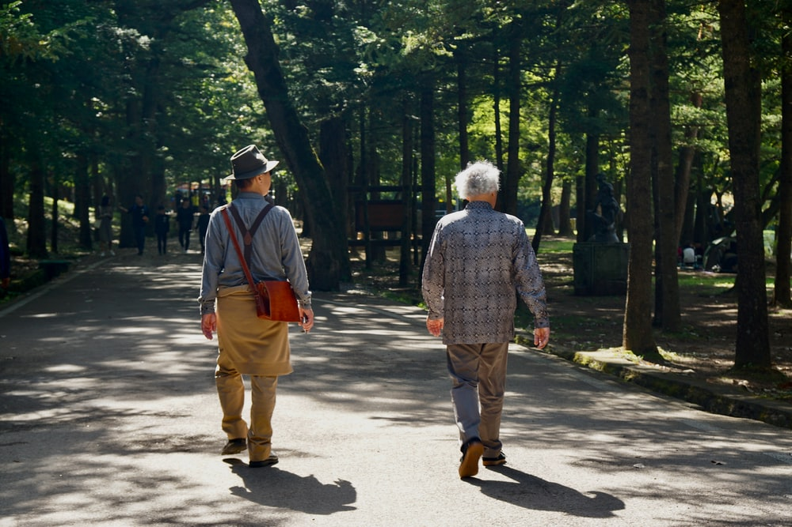
Caveat: Before starting any new exercise program, consult with your doctor and always start slow

Slide 5
What are your reasons to start exercising?
Notes:
Have the participants write on sticky notes what are some reasons to start exercising. After everyone wrote down a few, I would group them together and share some of the categories. Some categories I think that would come up are being able to live independently, stay healthy, and have the ability to interact with grandchildren

Slide 6
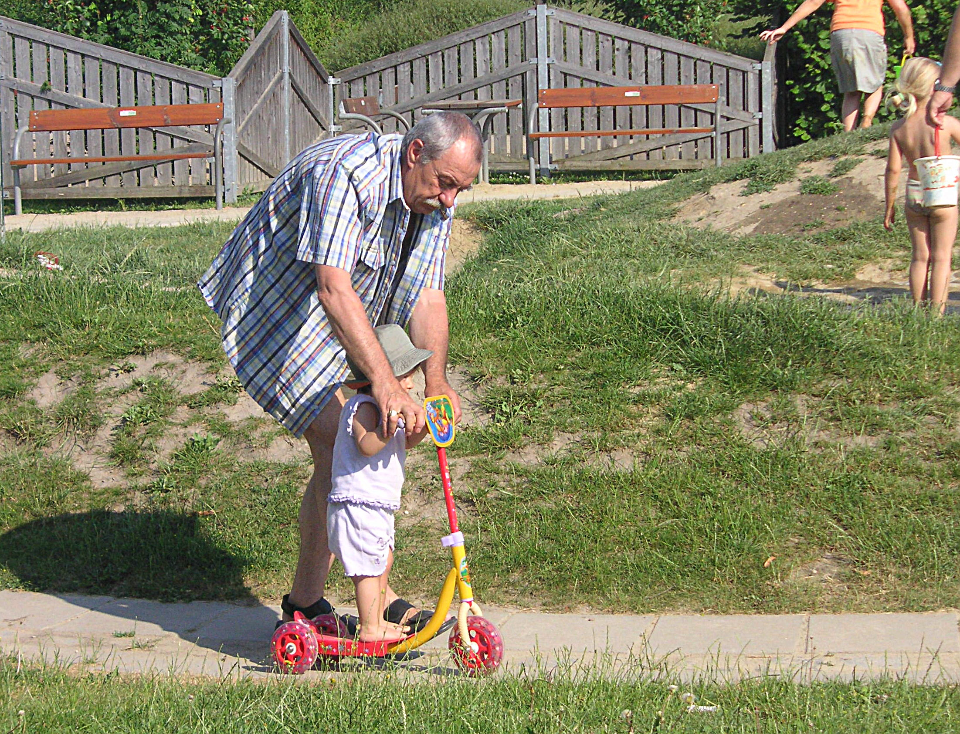
What are your reasons to start exercising?

Slide 7
Physical activity allows us to fulfill our goals
Improve health
Feel better
Prevent age-related declines in functioning
Reduce likelihood of injuries
Live independently longer
Have the ability to spend time with those you care about

Slide 8
Research shows regular exercise is associate with lower rates of several illnesses, including:
Diabetes
Cancer
Arthritis
Depression
Dementia

Slide 9
What are your goals?
Think-pair-share
What does physical activity look like for you now?
What do you want it to look like?
Notes:
Think-pair-share
Have participants think about the answers to these questions for one minute.
Have participants turn to person next to them and discuss answers for two minutes.
Go around room and allow one person from each pair to share with group what they discussed.

Slide 10
The problem with Present bias
People prioritize things that feel good now, like sitting on the couch watching TV, over things, like exercise, that will have benefits over the long run
How do we break that cycle and start a new habit?

Slide 11
Habit formation and behavior change
Habits are automatic responses to environmental cues, developed through repetition
Almost half of all our daily actions are out of habit
We want to make regular exercise one of those habits

Slide 12
Many of the following examples apply to walking, which is an easy and safe activity for most older adults
However, the same principles apply to other forms of regular exercise (and many other new habits you want to start)

Slide 13
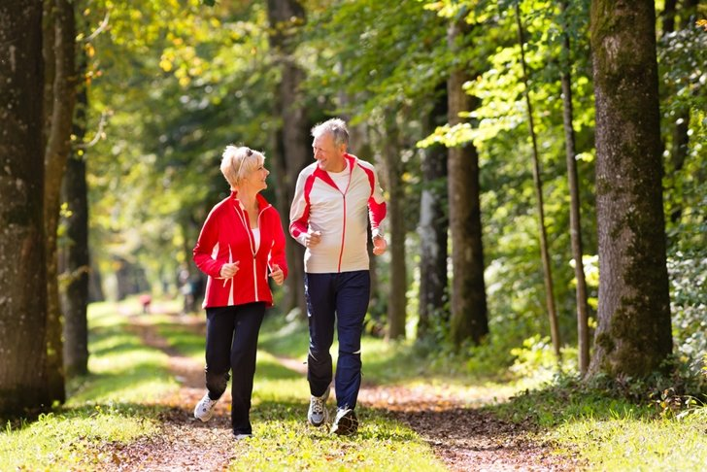
How to establish a new habit
What does the research say?
Bottom line: Make it easy and make it fun!

Slide 14
Don’t let the perfect be the enemy of the good
Better to do enjoyable activity, like walking in a nice park, regularly than more rigorous but less fun activity, like running on a track, infrequently

Slide 15
Start small
Set easy goals like walking to the end of the block and back
Consistency is more important than quantity
Great benefits to just a few minutes of exercise each day

Slide 16
Take advantage of transition points
New habits are more likely to stick when they coincide with natural transitions, such as the beginning of the month or a move to a new neighborhood

Slide 17
Identify specific time and location
When people identify specific time and location, they are more than twice as likely to follow through
For example, “Tomorrow at 10 am, I will walk around the block”

Slide 18
Take advantage of the new day
We are most likely to follow through on something first thing in the morning
As the day goes on, other factors can derail our good intentions

Slide 19
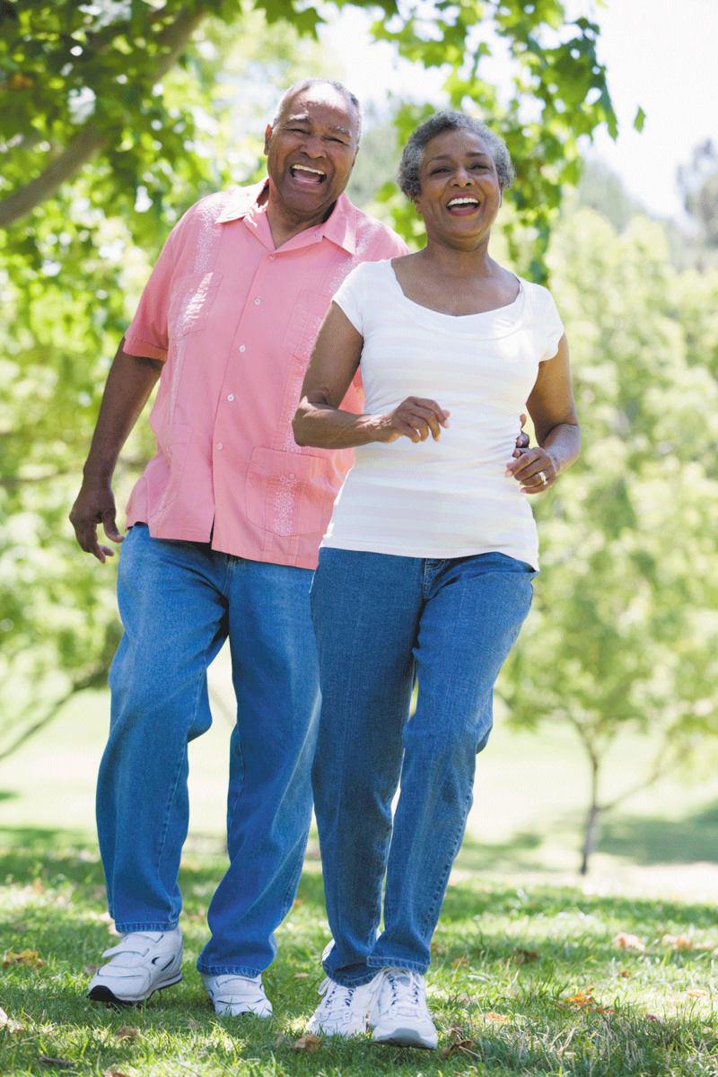
Minimize “friction”
Eliminate as many barriers as possible to getting out the door
For example, put on your walking clothes and walking shoes first thing in the morning, so you don’t have to change

Slide 20
Eliminate decisions
Make a new rule you always follow without thinking about it
For example, “I will go for a short walk with the dog rather than just letting her or him out”

Slide 21
Create a visual cue or other reminders
What will help you remember to exercise?
For example, put a sticky note on your bathroom mirror
Keep your walking shoes right next to your bed
Leave your Fitbit next to the coffee machine
Set an alarm

Slide 22
Use the power of habit stacking
Link something you already do with something you want to do
For example, “Right after I finish my first cup of coffee, I will go for a 10-minute walk”

Slide 23
Use “temptation bundling” to your advantage
Make exercise something you look forward to by pairing it with something that is immediately fun
For example, “I will only listen to my favorite podcast or audiobook when I am walking”

Slide 24
Create “if-then” rules
Make something fun dependent on exercising
For example, “If I have gone for a walk, then I can have dessert”

Slide 25
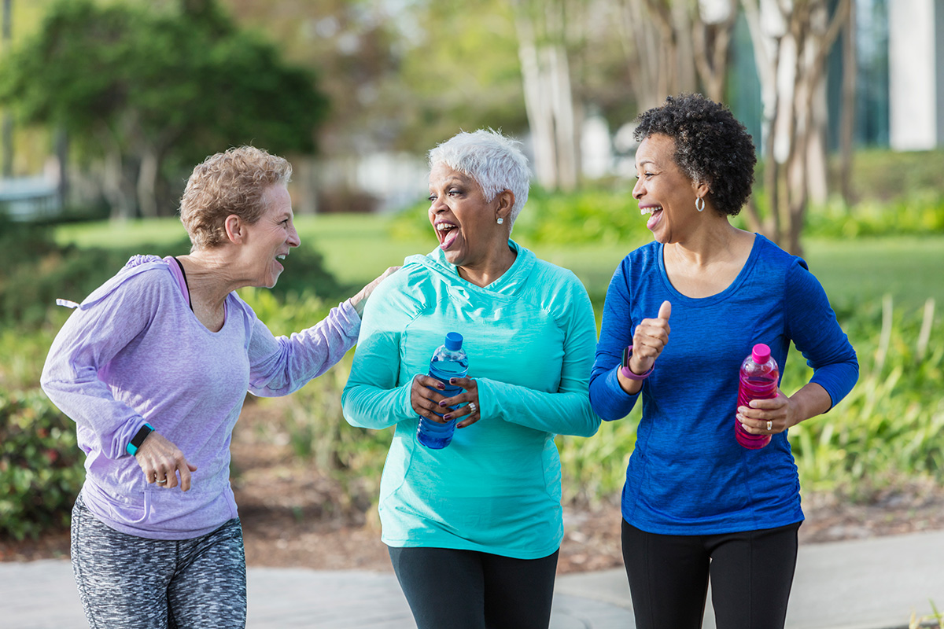
Be social!!! This is one of the best ways to begin and sustain a new habit
Find a friend to exercise with
Attend an exercise class
Join a dance club

Slide 26
Make your new habit public
Tell others about your exercise goals so you will be more likely to follow through

Slide 27
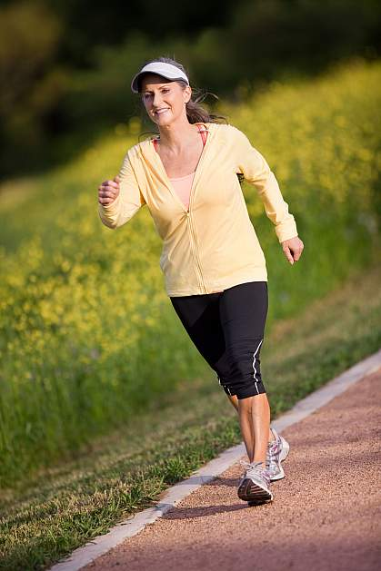
Set an obtainable goal
See if you can exercise every single day for a month

Slide 28
Track progress
Measuring something helps change it
Crossing off something from a to-do list is reinforcing
For example, put a red “X” through every day on your calendar in which you exercise

Slide 29
Reward yourself
Find a way to reward yourself for all your hard work
For example, “If I exercise every day for a month, I will go to dinner at my favorite restaurant”

Slide 30
Learn to talk back to negative thoughts
Identify ways to respond to undermining thoughts
For example, if you find yourself thinking, “I’m not in the mood to walk today. I’ll do it tomorrow,” you could say to yourself, “I don’t have to be in the mood to take a walk. Mood is irrelevant. I just need to walk, whether I’m in the mood or not”

Slide 31
Never miss twice
If you break your streak, start up again as soon as possible
Missing once is an accident, but missing twice is the unfortunate start of a new habit

Slide 32
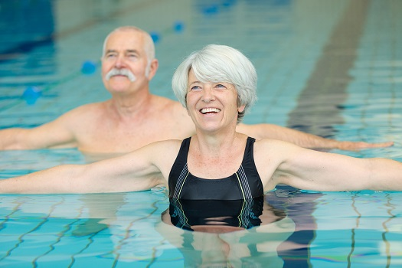
Barriers
Think-pair-share
What kinds of things get in the way of your exercising regularly?
What can you do to overcome those barriers?
Notes:
Think-pair-share
Have participants think about the answers to these questions for one minute.
Have participants turn to person next to them and discuss answers for two minutes.
Go around room and allow one person from each pair to share with group what they discussed.

Slide 33
Overcome your barriers
As a group, identify five (or so) strategies that seem most effective in overcoming barriers

Slide 34
Create a plan
Take 2 minutes, to complete the worksheet on setting up your individual exercise plan
Share it with a partner

Slide 35
Available resources
What resources exist in your community?
Senior centers
Silver Sneakers
Senior classes at local YMCA or gyms
Square dance clubs
Strong Bodies through University of Wisconsin-Madison Extension
Notes:
Have participants identify resources they might know of in their community that are focused on excercise

Slide 36
Summary
Regular exercise can help us achieve our goals
Regular exercise is associated with multiple health benefits
Research has identified numerous strategies that make new habits more likely to stick
Which strategies do you think will be most useful to you?

Slide 37
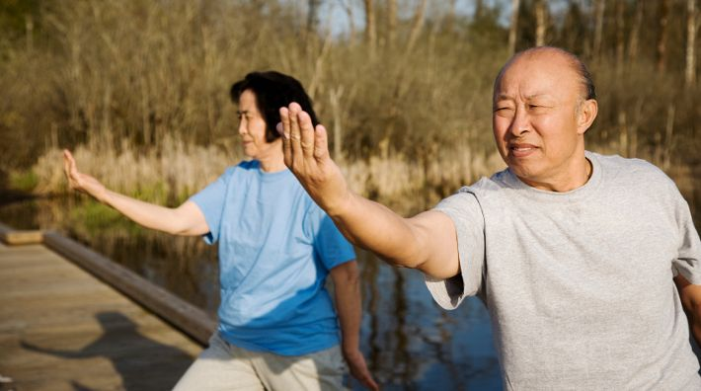
Start your new exercise program today while you are feeling inspired!

Slide 38
Remember to be kind to yourself …
Often takes multiple attempts to successfully start new habit or break old habit
Keep trying until it sticks!

Slide 39
Additional readings
Atomic Habits: Tiny Changes, Remarkable Results by James Clear
How to Change: The Science of Getting from Where You Are to Where You Want to Be by Katy Milkman

Slide 40
Thank you!

