Slide 1
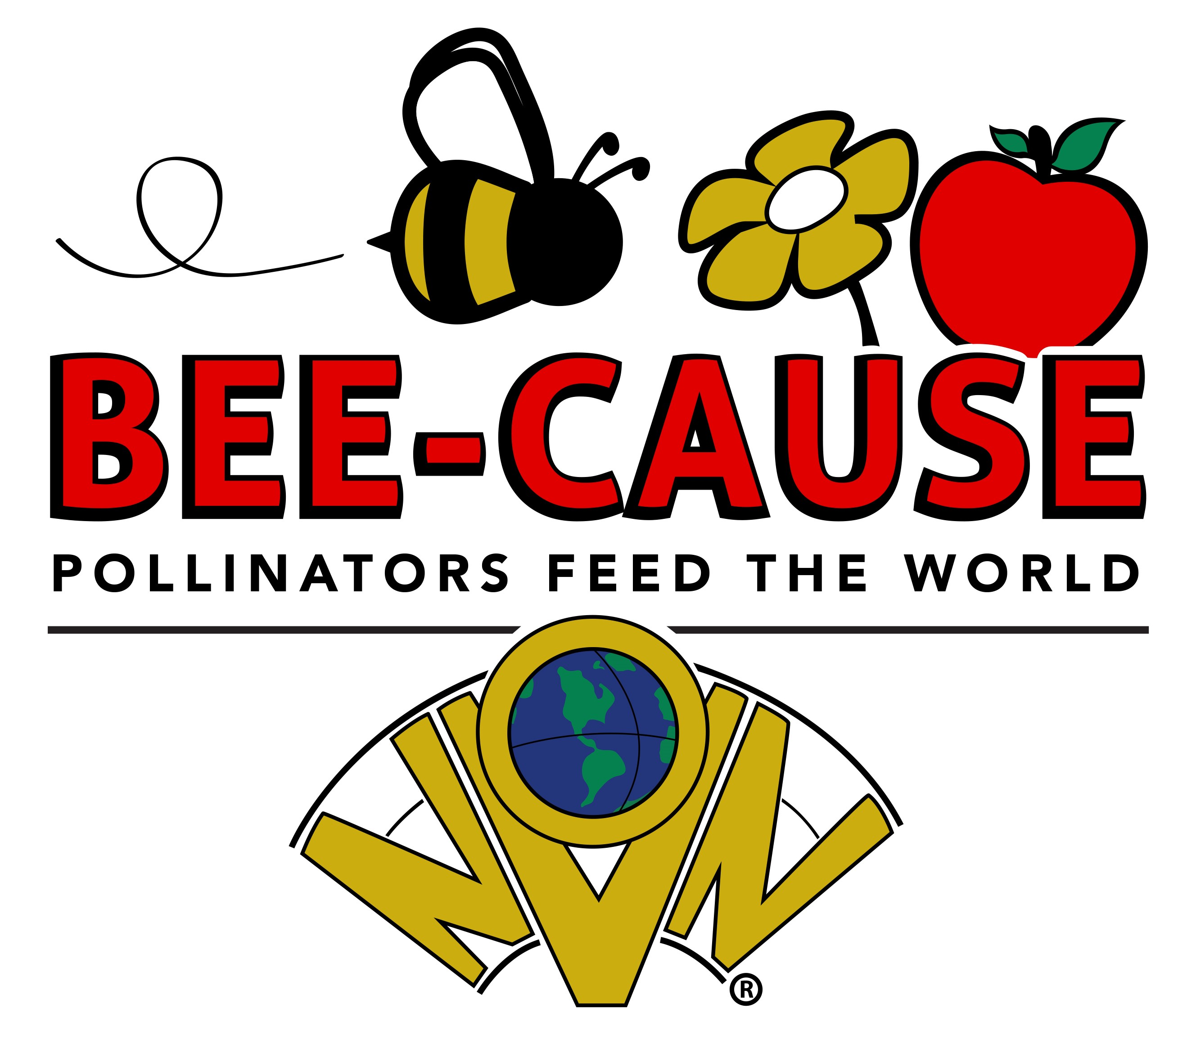
Project In Common 2022-2024

Slide 2
Worldwide, approximately 1,000 plants grown for food, beverages, fibers, spices and medicines need to be pollinated by animals in order to produce the resources on which we depend.

Slide 3
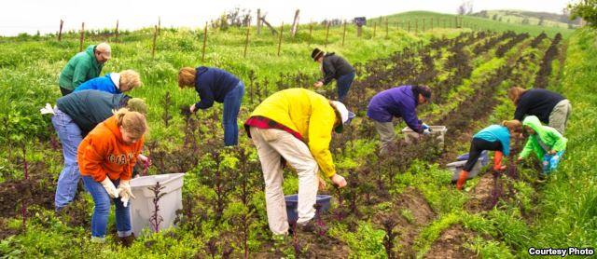
This Photo by Unknown Author is licensed under CC BY

Slide 4
• Foods produced with the help of pollinators include apples, strawberries, blueberries, chocolate, melons, peaches, figs, tomatoes, pumpkins & almonds.
• In the United States, pollination by honey bees and other insects produces nearly $20 billion worth of products annually!

Slide 5
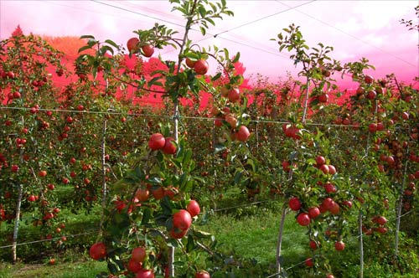
This Photo by Unknown Author is licensed under CC BY-NC

Slide 6
About 75% of all flowering plants rely on animal pollinators for fertilization and over 200,000 species of animals act as pollinators.
Of those, about 1,000 are hummingbirds, bats and small mammals, such as mice. The rest are insects, such as beetles, bees, ants, wasps, butterflies, and moths.

Slide 7
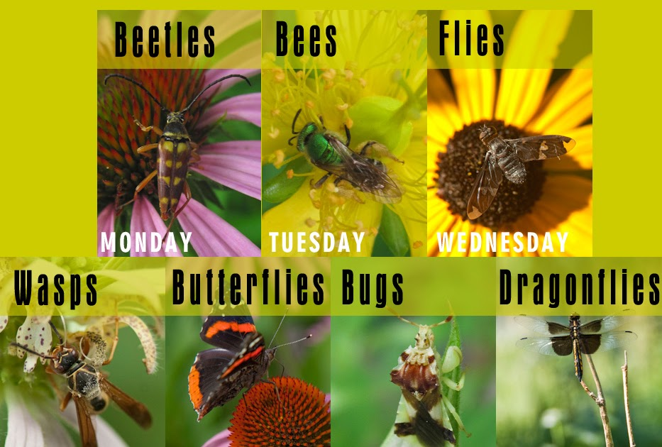
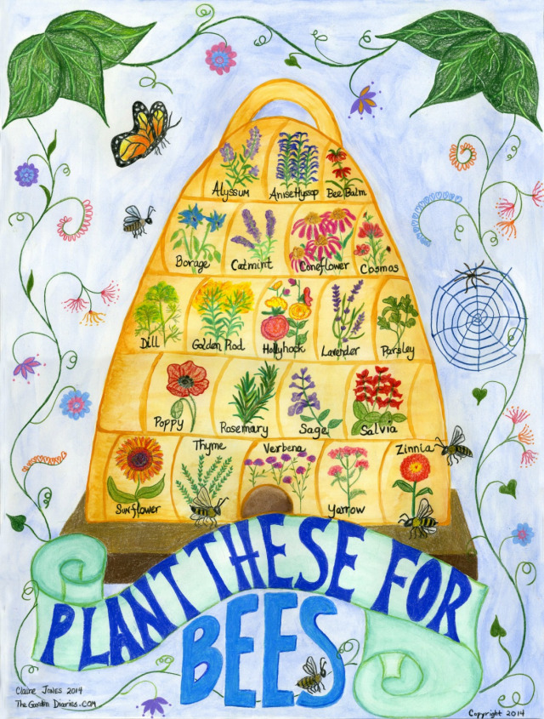
This Photo by Unknown Author is licensed under CC BY-SA-NC
This Photo by Unknown Author is licensed under CC BY-NC-ND

Slide 8
Our farm and ranch lands that support pollinators are disappearing at the alarming rate of 3,000 acres a day.
The remaining farm and ranch lands lose pollinators' valuable services as their surrounding habitat declines.

Slide 9
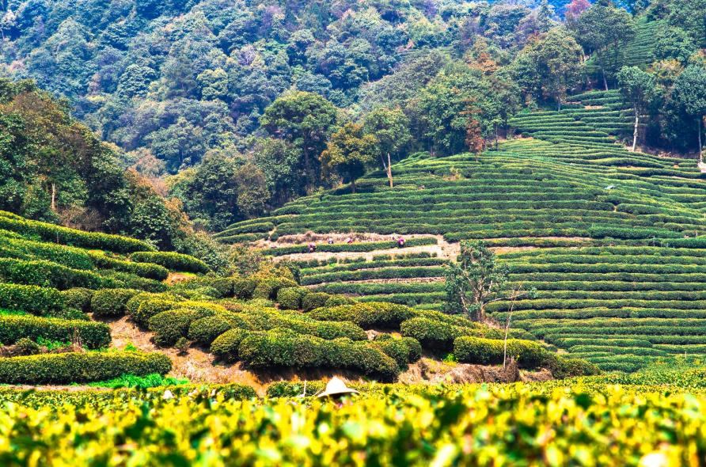
This Photo by Unknown Author is licensed under CC BY-ND

Slide 10
Adding natural habitat areas into farm systems works.
Farms that are closer to natural habitat produce more crop yield because they attract more pollinators.
Adding habitat to farms systems works too – farms that have turned a portion of their fields into green space have gained back more overall yield.

Slide 11
Home owners can help too! Home gardens can and do attract pollinators, and in many cases suburbs and cities have been shown to have more diverse pollinator communities than nearby wildlands.
Pollinators don’t seem to be phased by city life, as long as there are plots and patches of flowers they will be visited by hungry bees.

Slide 12
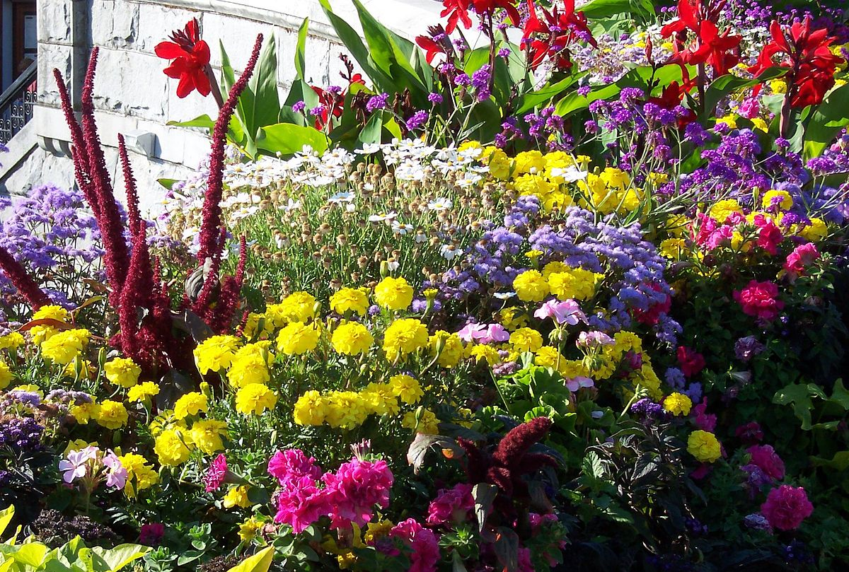
This Photo by Unknown Author is licensed under CC BY-SA

Slide 13
Pollinator gardening near community gardens also increases urban agricultural yields.
If you build it, they will come and help you get bigger and better crops too!

Slide 14
With over 32,000 members NVON will make a major impact with education and implementation of workshops, home gardens, flower beds and LOTS of other areas to help make members and others aware of the crisis with pollinators.

Slide 15
Each state organization may partner with their state extension office and other organizations to hold minimum of 3 educational classes and /or workshops for adults/children annually. The subjects could be bees, pollinators, plants, pesticide danger.

Slide 16
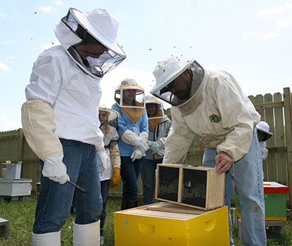
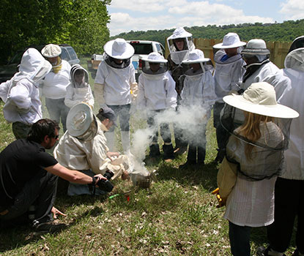
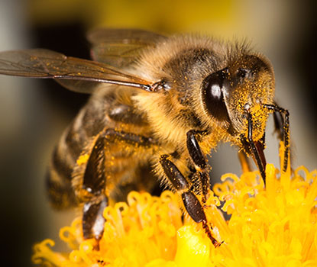
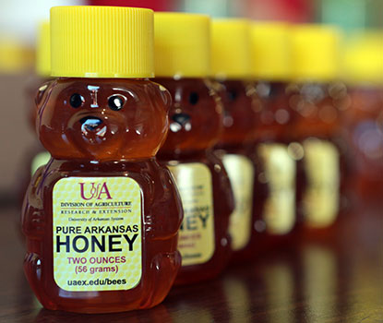
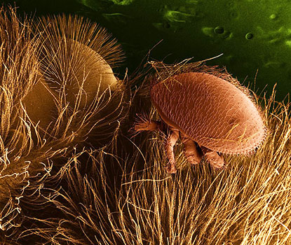
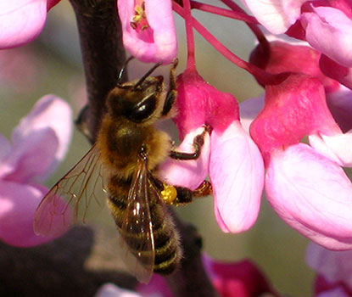
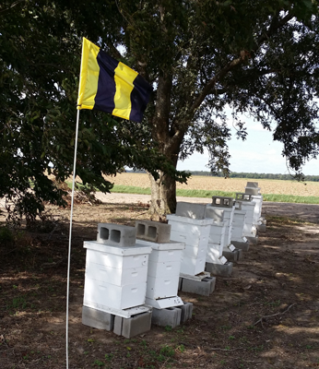
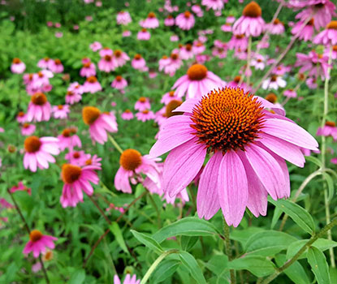
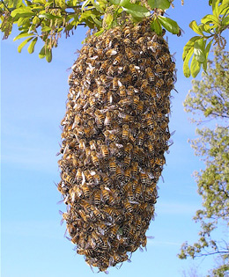
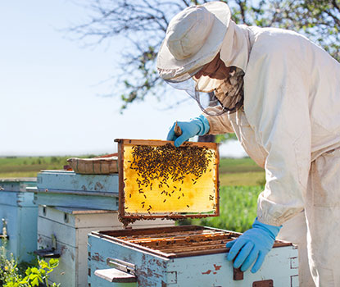
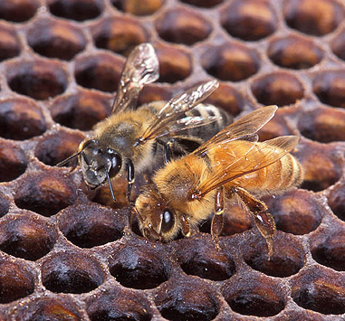
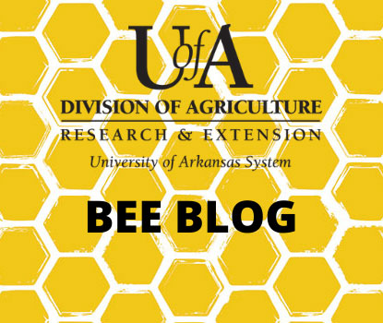
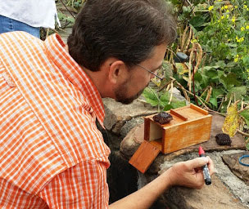
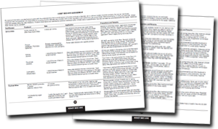
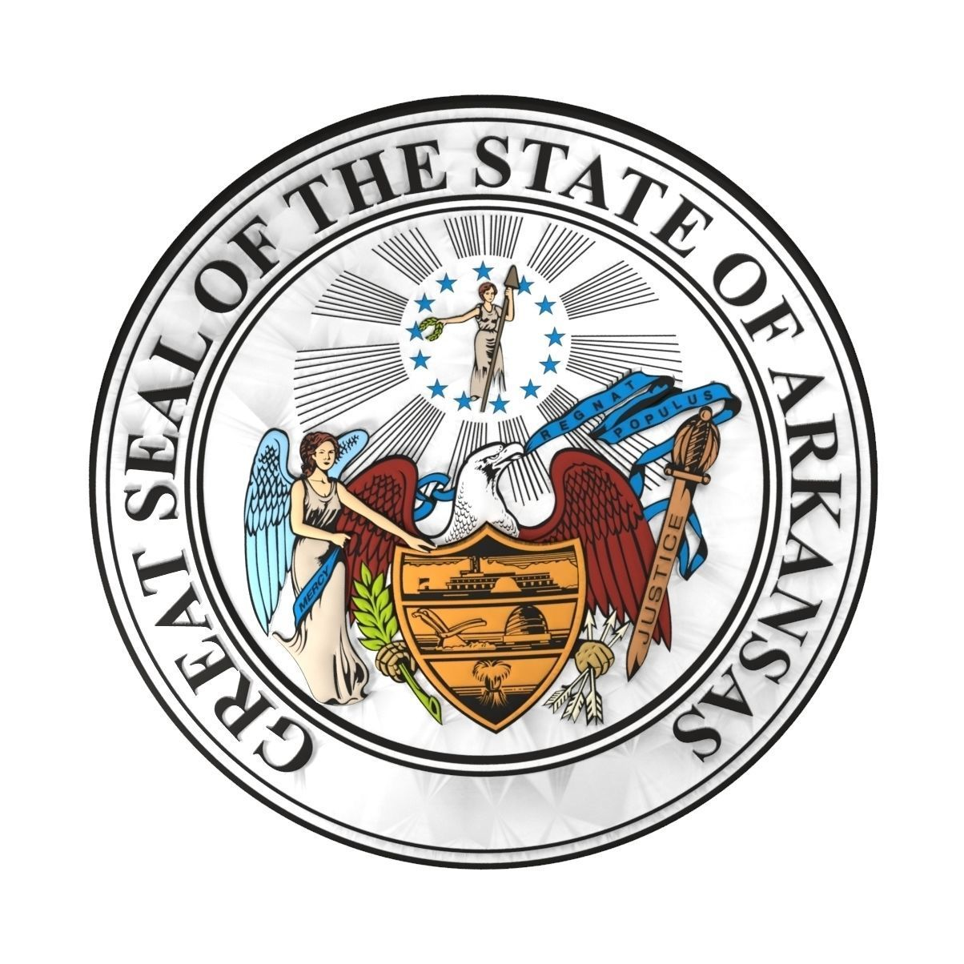
Beekeeping in Arkansas
Getting Started
Beekeeping Classes & Events
About Honey Bees
Honey
Bee Hive Pests & Diseases
Bees as Pollinators
Pollinator Protection
Honey Plants
Honey Bee Swarms
Africanized Honey Bees in Arkansas
Bee Lining
4-H Beekeeping Essay Contest
Beekeeping Publications
UA Bee Blog
Beekeeping Calendar
Beekeeping Basics
Contact
Jon Zawislak Apiculture Instructor Phone: 501-671-2222 Fax: 501-671-2252 Email: jzawislak@uada.edu Web: uaex.uada.edu/bees
Office: University of Arkansas Division of Agriculture Cooperative Extension Service 2301 S. University Avenue Little Rock, AR 72204
Connect with us!
Beekeeping - Apiculture in Arkansas
Get Started
Take a Beekeeping Class
Explore Honey Bees
Learn All About Honey
Bee Hive Pests & Diseases
Bees as Pollinators
Protecting Pollinators
Africanized Bees
Bee Lining
National 4-H Beekeeping Essay Contest
Beekeeping Publications
UA Bee Blog
Beekeeping Calendar
Did you know?
The honey bee, Apis mellifera, was designated as the State Insect of Arkansas because of its invaluable contribution to agriculture. The official seal of the State of Arkansas even features a bee hive among its other symbols of industry.
Beekeeping in Arkansas
Getting Started
Beekeeping Classes & Events
About Honey Bees
Honey
Bee Hive Pests & Diseases
Bees as Pollinators
Pollinator Protection
Honey Plants
Honey Bee Swarms
Africanized Honey Bees in Arkansas
Bee Lining
4-H Beekeeping Essay Contest
Beekeeping Publications
UA Bee Blog
Beekeeping Calendar
Beekeeping Basics
Contact
Jon Zawislak Apiculture Instructor Phone: 501-671-2222 Fax: 501-671-2252 Email: jzawislak@uada.edu Web: uaex.uada.edu/bees
Office: University of Arkansas Division of Agriculture Cooperative Extension Service 2301 S. University Avenue Little Rock, AR 72204
Connect with us!
Beekeeping - Apiculture in Arkansas
Get Started
Take a Beekeeping Class
Explore Honey Bees
Learn All About Honey
Bee Hive Pests & Diseases
Bees as Pollinators
Protecting Pollinators
Honey Plants
Honey Bee Swarms
Africanized Bees
Bee Lining
National 4-H Beekeeping Essay Contest
Beekeeping Publications
UA Bee Blog
Beekeeping Calendar
Did you know?
The honey bee, Apis mellifera, was designated as the State Insect of Arkansas because of its invaluable contribution to agriculture. The official seal of the State of Arkansas even features a bee hive among its other symbols of industry.
Honey Plants

Slide 17
Associated Country Women of the World
Resolution 16 POLLINATOR PROTECTION
Be it resolved that ACWW societies and members urge their governments and research institutes to continue to identify and reduce specific drivers of insect pollinator decline, develop agricultural pollinator friendly practices, and promote greater public awareness of the role of insect pollination in global food production.

Slide 18
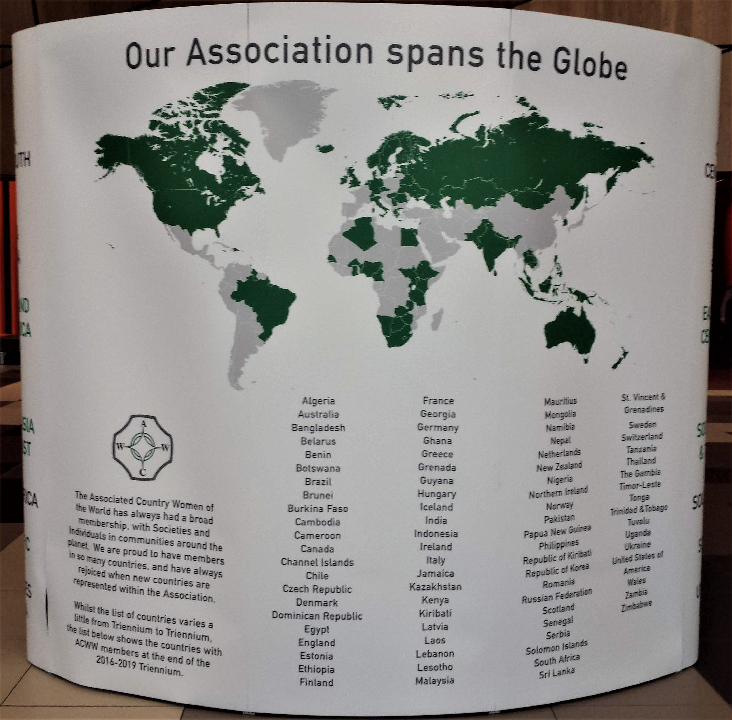

Slide 19
Bees for Development, United Kingdom
Bees for Development is an international organization that utilizes beekeeping as a tool to alleviate poverty and retain biodiversity around the world.
They work in over 50 countries within local communities, and implement sustainable beekeeping techniques that use only local bees and local resources.
They have an open-access information portal that provides information on bees and beekeeping worldwide.

Slide 20
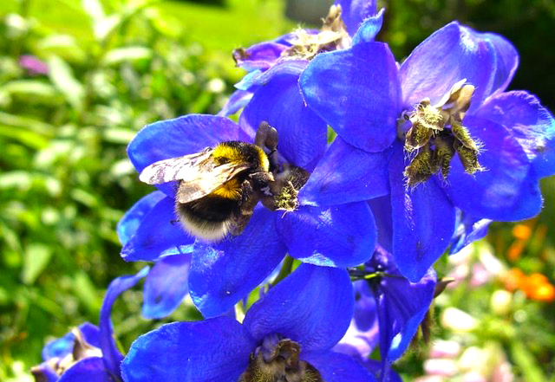
This Photo by Unknown Author is licensed under CC BY

Slide 21
By donating $1.00 (one dollar) per member toward providing bee hives for Bees for Development – one hive and educational material sent to other countries averages $70 per hive.
We WILL Make a Difference

Slide 22
How Bees for Development
made lives better with Bees 2020
1500 bee colonies were established in cashew and citrus orchards in Ghana
38,000 bee tree seedlings were planted in Ethiopia
450 people in Ethiopia became new beekeepers
144 landless youth completed beekeeping training in Ethiopia
300 families in Ethiopia gained from land restoration across two sites
391 people became beekeepers near Digya National Park in Ghana 90 beekeeper-mentoring relationships established in Ethiopia

Slide 23
964 local-style hives were made by beekeepers in projects in Ghana
32 people with disabilities became beekeepers in Uganda
46 people from this many nations joined our webinars 55 people in Uganda were trained in beeswax processing
60 hectares of land are being restored in Ethiopia
60 people from this many nations sought our advice

Slide 24
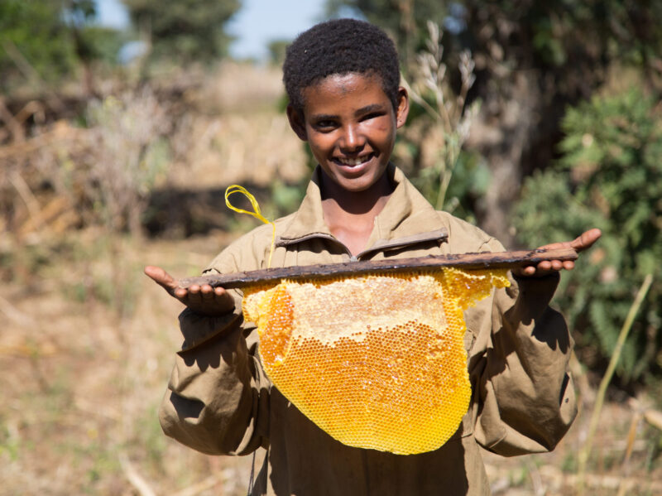

Slide 25
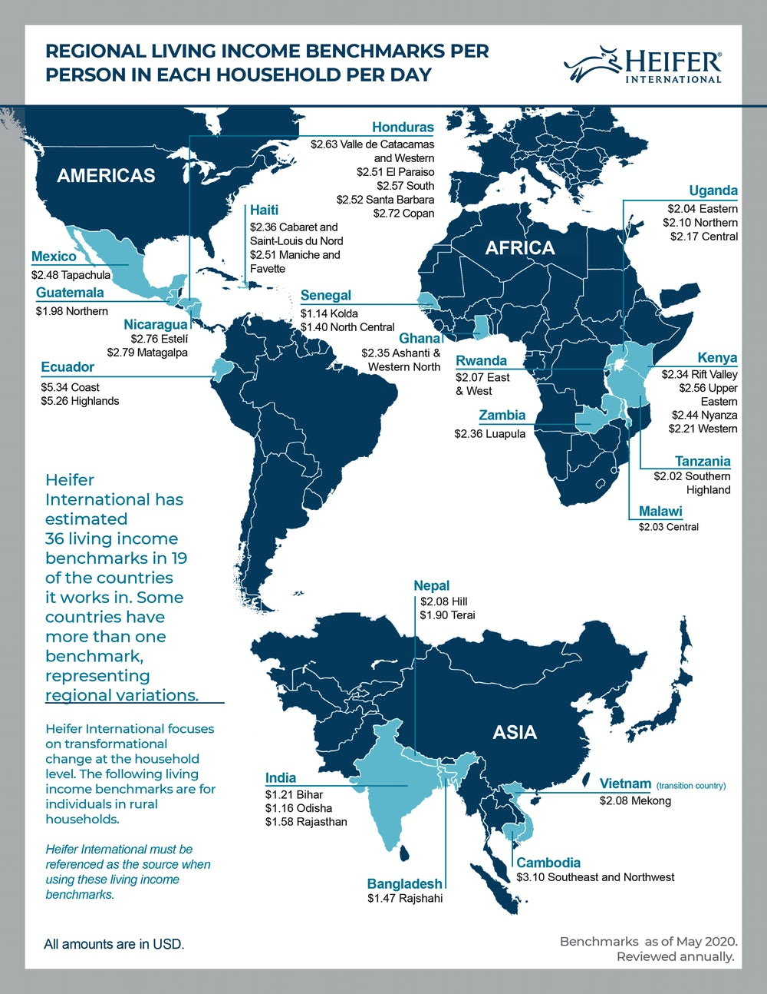

Slide 26
A Heifer honeybee gift donation includes a bee package, hive, box and training in beekeeping techniques. When you buy bees for a family in need, your gift:
Increases the global honeybee population to support the environment
Boosts income through sales of honey, wax and pollen
Stimulates growth of the family’s crops through pollination
Heifer International will provide one beehive for $30.

Slide 27
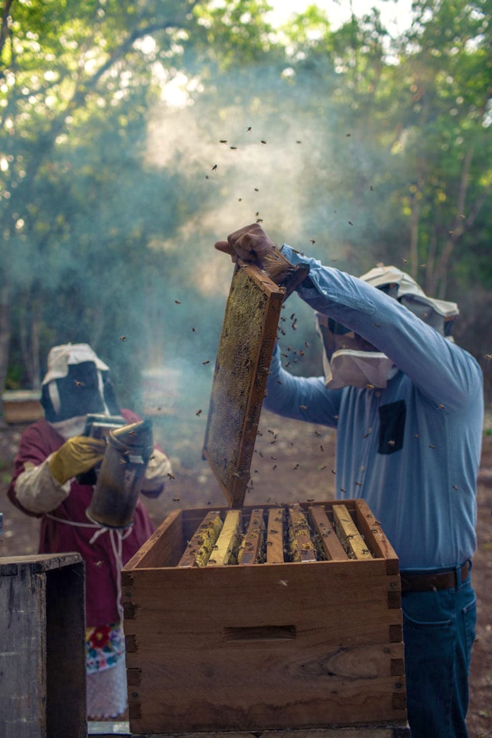

Slide 28
Nationally Educate Voluntarily Donate Openly Advocate Now
Part of the Pollinator Solution

Slide 29
If we can YOU can

Slide 30
Project In Common 2022-2024

Slide 31
Complete form / send to Karen Bell Fox quarterly –beginning March, 2022
Send money and a copy of form to
Nancy Jo Prue, NVON Treasurer,
4604 W. 1200 S.
Kentland, Indiana 47951
PROJECT IN COMMON REPORT FORM
State _________________________ Contact Name_________________________
Email _________________________ Phone number________________________
# Volunteers __________________ # Volunteer hours_____________________
# Dollars contributed_________________# People reached_________________
Designate Type (s) of Project and number of Projects
Educational (Leader Training, Civic Groups, etc.)
Bees___________________________________________________________________________
Other Pollinators______________________________________________________________
Pollinator flower gardens_____________________________________________________
Demonstration gardens_______________________________________________________
Fund Raisers BEE-CAUSE program___________________________________________
Classroom presentations_____________________________________________________
Email to Karen Bell Fox
NVON Project in Common Chair
karenbellfoxaehc@yahoo.com
870-325-7238 or 870-692-4097

Slide 32
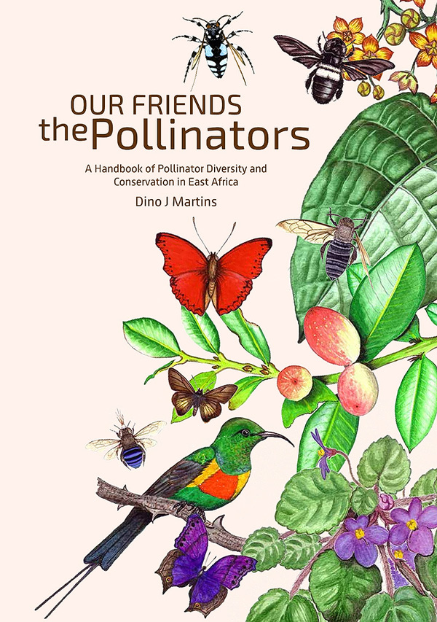
This Photo by Unknown Author is licensed under CC BY-NC-ND

Slide 33
This Photo by Unknown Author is licensed under CC BY-SA-NC

