Slide 1
Getting Started with Advance Care Planning
Advance Medical and Legal Directives
Jackie Carattini, UW-Madision Division of Extension

Slide 2
Before We Begin…
Notes:
There is no doubt that death and thinking about our mortality is a big and heavy topic. And in our culture, death is rarely talked about out in the open, so most of us don’t have a lot of experience talking about it. Please know that if emotions arise during our time together, that it is okay and it is normal. If you feel you need to take a break, that’s okay too. We recognize that we might not all have the same comfort level, or have the same experiences, or have the same knowledge base.
Please acknowledge this prior to beginning. Please be supportive of members if emotions arise.

Slide 3
Advance Directives
Medical Advance Directives come in two main types:
Living Wills
Medical powers of attorney
***Note Financial power of attorney is separate but often considered at the same time.
Notes:
Advance Directives, Living Wills, Powers of Attorney: What’s the difference? These legal documents have different names , but just one goal- helping you direct your health care if you or your loved one becomes unable to communicate their wishes. By discussing your or your loved one’s end-of-life wishes and establishing a legal document called an advance directive, you ensure that your or their wishes for treatment and care will be honored if you or they become unable to communicate or make decisions.
Advance directives come in two main types:
Living wills
Medical powers of attorney (Financial power of attorney is separate but often considered at the same time).
Everyone can benefit from advance planning for health care. Unlike many states, Wisconsin is not a “next of kin” or “family consent” state for adults. That means Wisconsin law does not let family members make decisions for incapacitated adult family members. As a general rule, spouses cannot make decisions for spouses, parents cannot make decisions for adult children, adult children cannot make decisions for parents, with some exceptions for hospice and emergency care.
See: http://www.nbexcellence.org/cms-files/resources/Basics-of-Gship.pdf

Slide 4
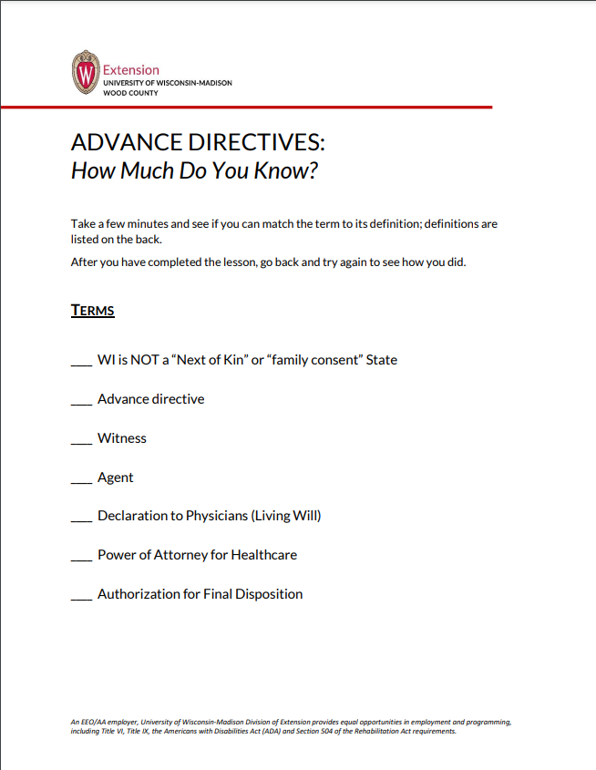
How Much Do You Know…
Let’s start with a quiz!
Take a few minutes to read the terms and definitions on the Advance Directives: How Much Do You Know worksheet. Try to “match” the correct answers.
Notes:
Let’s start with a quiz!
Take a few minutes to read the terms and definitions on the Advance Directives: How Much Do You Know worksheet. Try to “match” the correct answers.
Now, as we go through the rest of the presentation make notes and corrections to your sheet.

Slide 5
Objectives:
Participants will demonstrate knowledge/understanding of: The structure and process for implementing advance directives.
Participants will recognize how to select people who will be responsible for their affairs if they become incapacitated.
Notes:
The objectives for this module are that:
Participants will demonstrate knowledge/understanding of: The structure and process for implementing advance directives.
Participants will recognize how to select people who will be responsible for their affairs if they become incapacitated.

Slide 6
Where are you starting:
Have you had any experience with
any of the advance directives with loved ones?
Have you already filled out any forms for yourself?
Notes:
Have a group discussion with one or both of these questions. Have you had any experiences with any of the above advance directives with loved ones? Have you already filled any out for yourself?
Discuss their answers in the group to see what are some similarities and differences
in their answers.
Ask if anyone is willing to share? If some do not want to share as a large group you can also have them discuss and share with their neighbor.

Slide 7
Descriptions:
Wisconsin laws have created three forms of advance directives:
Wisconsin Living Will (Declaration to Health Care Professionals).
The Power of Attorney for Health Care
Power of Attorney for Finance and Property
Notes:
An advance directive describes, in writing, your choices about the treatments you want or do not want or about how health care decisions should be made for you if you become incapacitated and cannot express your wishes. Anyone who is of sound mind and age 18 or older may complete these forms. They also clarify who you would like to handle your financial and medical decisions if you are not able to make them for yourself.
Wisconsin laws have created 3 forms of advance directives.
Wisconsin Living Will (Declaration to Health Care Professionals)
Power of Attorney for Health Care
Power of Attorney for Finance and Property
NOTE- If you are a snow bird or travel to other states throughout the year, please check the laws on advance directives in the other state. For example, Arizona law states that YES a advance directive from another state is valid in Arizona.

Slide 8
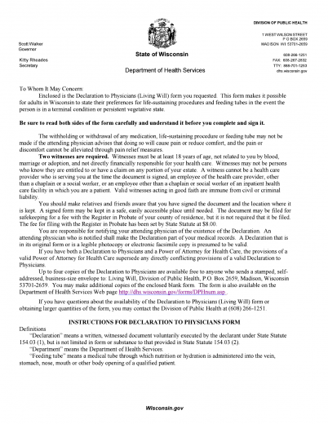
A Living Will:
A Wisconsin Living Will
(Declaration to Health Care Professionals) allows you to select the kind of life-sustaining care you would want if injury or illness leaves you in a terminal condition (dying) or a persistent vegetative state with no hope of recovery.
Notes:
In WI a living will is defined as: A Wisconsin Living Will (Declaration to Health Care Professionals) allows you to select the kind of life-sustaining care you would want if injury or illness leaves you in a terminal condition (dying) or a persistent vegetative state with no hope of recovery.
Ask the group if anyone has had experience with a living will.

Slide 9
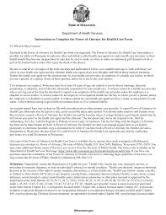
Power of Attorney for Health Care:
In a Power of Attorney for Health Care,
you appoint someone to be your “agent” to make
all health care decisions – not just those involving life support – for you if you lose the ability to make decisions for yourself.
Notes:
Review the definition of a Power of Attorney for Health Care and ask the group if they have had any experience with one.
In WI. a Power of Attorney for Health Care is when you appoint someone to be your “agent” to make all health care decisions- not just those involving life support- for you if you lose the ability to make decisions for yourself.
Your Right to Direct Your Future Health Care Needs: Who Will Make Your Medical Decisions When You Can't, is a publication from the Department of Health Services that provides additional information and resources regarding advance directives.
Consumer's Tool Kit for Health Care Advance Planning, from the American Bar Association, includes question and answer forms to help you and your family think and talk about end-of-life health care issues.

Slide 10
Power of Attorney for Finances and Property
Does not have to be the same individual as your Power of Attorney for Health Care.
Authorizes another person (your agent) to make decisions concerning your property for you (including your money).
Notes:
The Power of Attorney of finances and property authorizes another person (your agent) to make decisions concerning your property for you (the principal). Your agent will be able to make decisions and act with respect to your property (including your money) whether or not you are able to act for yourself.
A key point to remember about the POA for finances and property are that it does not have to be the same individual as your POA for healthcare.
Does anyone have any experience with declaring a POA for Finances and Property?
This Power of Attorney for Finances form allows you to plan for future financial decision-making even if you are unable to make your own decisions.
This form is not the answer for everyone. Only select someone you trust to be your agent. You may wish to consult with an attorney to explore other financial planning tools such as a Power of Attorney for Finances drafted by an attorney, or special accounts or trusts. This is an important legal document. Do not sign it until you, and your chosen agent, understand the powers being granted. By signing this document, you are not giving up any powers or rights to control your finances or property. Instead, you are giving your agent, in addition to yourself, the authority to handle your finances and property. While it is not required that you sign this document in the presence of a notary, acknowledged signatures create a lawful presumption of genuineness and will be more easily accepted by businesses and financial institutions.
This document is effective immediately when executed unless you state a future date or occurrence that will activate the powers expressed in this form. This Power of Attorney for Finances is “durable” (does not terminate upon the principal’s incapacity) unless you specifically state that it terminates if you become incapacitated.
If you name your spouse or domestic partner as your agent and the marriage or domestic partnership is terminated (annulment or divorce), this document becomes invalid unless the special instructions in this document state that such an action will not terminate the authority given to the agent. If you used a former state Power of Attorney for Finances form, that form is still valid. Executing a new Power of Attorney for Finances does not, automatically, revoke a prior document. If you wish to change this Power of Attorney for Finances in the future, you must complete a new document and revoke this one. You may revoke this document at any time; a suggested method is a written and dated statement expressing your intent to revoke this document. If you revoke this document, you should notify your agent and any other persons or entities that have a copy.
You should select someone you trust to serve as your agent. Unless you specify otherwise, generally the agent’s authority will continue until you die or revoke the Power of Attorney or the agent resigns or is unable to act for you.

Slide 11
Other Legal Forms to Consider:
Do-Not-Resuscitate (DNR) Information-
You Can Find Information on:
Issuing a DNR order
Revoking a DNR order
DNR bracelets
https://www.dhs.wisconsin.gov/ems/dnr.htm
Notes:
Since these are “Legal Terms and Forms” it is important to note our definitions are coming right out of the WI state statutes.
As defined in Wis. Stat. s. 154.17 (2), a do-not-resuscitate order directs emergency medical technicians, first responders and emergency health care facilities personnel not to attempt cardiopulmonary resuscitation on the person for whom the order is issued if that person suffers cardiac or respiratory arrest. The purpose of a do-not-resuscitate order is to ensure that medical care provided in the emergency department and out-of-hospital settings is consistent with the patient's desire and the attending physician's authorization.
If you visit the DNR page you will find more information on:
(https://www.dhs.wisconsin.gov/ems/dnr.htm)
Issuing a DNR order (attending physician responsibilities)
Revoking a DNR order
DNR identification bracelets
Ordering materials

Slide 12
Other Legal Forms to Consider:
Organ Donation
Access to and Privacy of Health Information (HIPPA)
POLST or Physician Orders for Life-Sustaining Treatment
Authorization for Final Disposition
Notes:
There are other legal forms that you may choose to consider. (If time allows, you can go into detail on each. If not, you can mention that these are all additional forms that may be available to you in WI.)
Organ donation- You can help save and improve lives by registering to be an organ and tissue donor when you renew your driver license or ID card. People of all ages can donate regardless of health history.
Registering means that you authorize the donation of your organs, tissues and eyes upon your death.
HIPPA- Is the federal Health Insurance Portability and Accountability Act of 1996. The HIPAA Privacy and Security Rules provide individuals with health information privacy rights and safeguard the health information. These rights are important for you to know so you can take charge of protecting your health information and know if your rights are being denied.
Health information rights include, but are not limited to:
Your right to access your health information.
Your right to correct or amend your health information.
Your right to file a complaint.
HIPAA balances the seamless electronic disclosures of your health information with technological safeguards. To make sure that your health information is protected in a way that does not interfere with your health care, information can be used and shared for your treatment and care coordination without waiting for consent.
Your health information cannot be used or shared without written permission unless HIPAA allows it
POLST or Physicians Orders for life-sustaining treatment- A POLST form is a doctor’s order that helps you keep control over medical care at the end of life. Like a Do Not Resuscitate (DNR) order, the form tells emergency medical personnel and other health care providers whether or not to administer cardiopulmonary resuscitation (CPR) in the event of a medical emergency. The POLST form may also provide other information about your wishes for end-of-life health care, as explained below.
In Wisconsin, the POLST form is currently available in hospitals, nursing homes, home health, and hospice settings in just a handful of counties. Check with your medical facility to see if they offer it. In the future, the form may become available in other parts of the state. A common question is what is the difference between a POLST or POST and a DNR. The DNR guides Emergency Medical Service (EMS) providers and can give EMS permission not to perform cardiopulmonary resuscitation (CPR), whereas a POLST might include a DNR instruction regarding CPR, but provides more instructions regarding additional medical interventions.
Authorization for Final Disposition- When properly completed and signed in the presence of two competent adult witnesses or a notary public, this voluntary document allows a competent adult (the declarant) to designate another competent adult (the representative or an alternative representative) to make funeral arrangements on behalf of the declarant.

Slide 13
How do you write an Advance Directive?
As you prepare your advance directive, you'll need to follow these four important steps:
Get the living will and medical power of attorney forms for your state or use a universal form that has been approved by many states.
Notes:
So now let’s talk about how to write your advance directive. You can start with the living will and POA for healthcare forms that are available from WI Department of Health Services. (see link below). You can also request these forms from your medical provider.
Wisconsin advance directive forms can be found on the Department of Health Services website: https://www.dhs.wisconsin.gov/forms/advdirectives/adformspoa.htm
The DHS site does have the forms available in English, Hmong, Spanish and Vietnamese. If you need the forms in another language, the source “Aging with Dignity” has them.

Slide 14
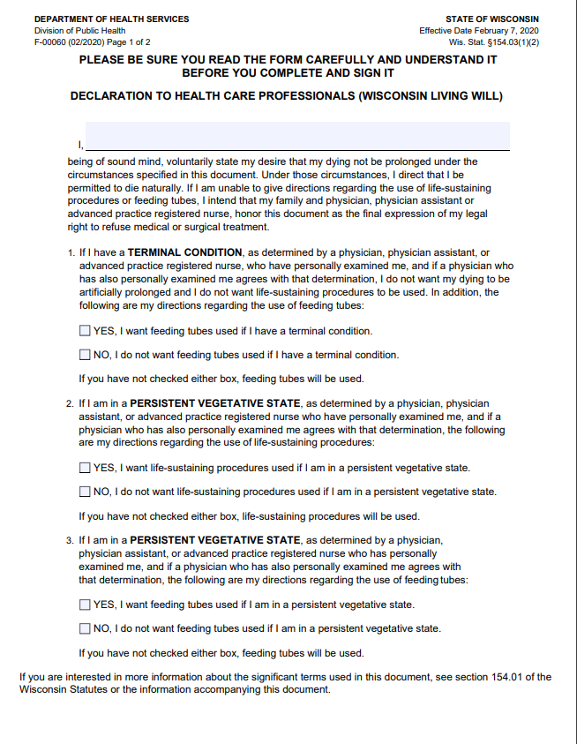
Example Form:
In order to have the most up date form, we suggest you get it from the DHS website or from your medical provider.
Here is a example of the WI. Living Will. As you can see it is fill in the blank.
Notes:
Here is an example of the WI Living Will form. (Or a portion of it. It is 5 pages long) This is one reason we have not provided you with copies. We also want to make sure it is the most up to date forms. These can be obtained from either the Department of Human Services website or directly from your healthcare provider.
The thought of filling out the forms can be overwhelming. The purpose of showing this example is to reinforce that the forms are check the box or fill in the blank so they are easy to follow and fill out.

Slide 15
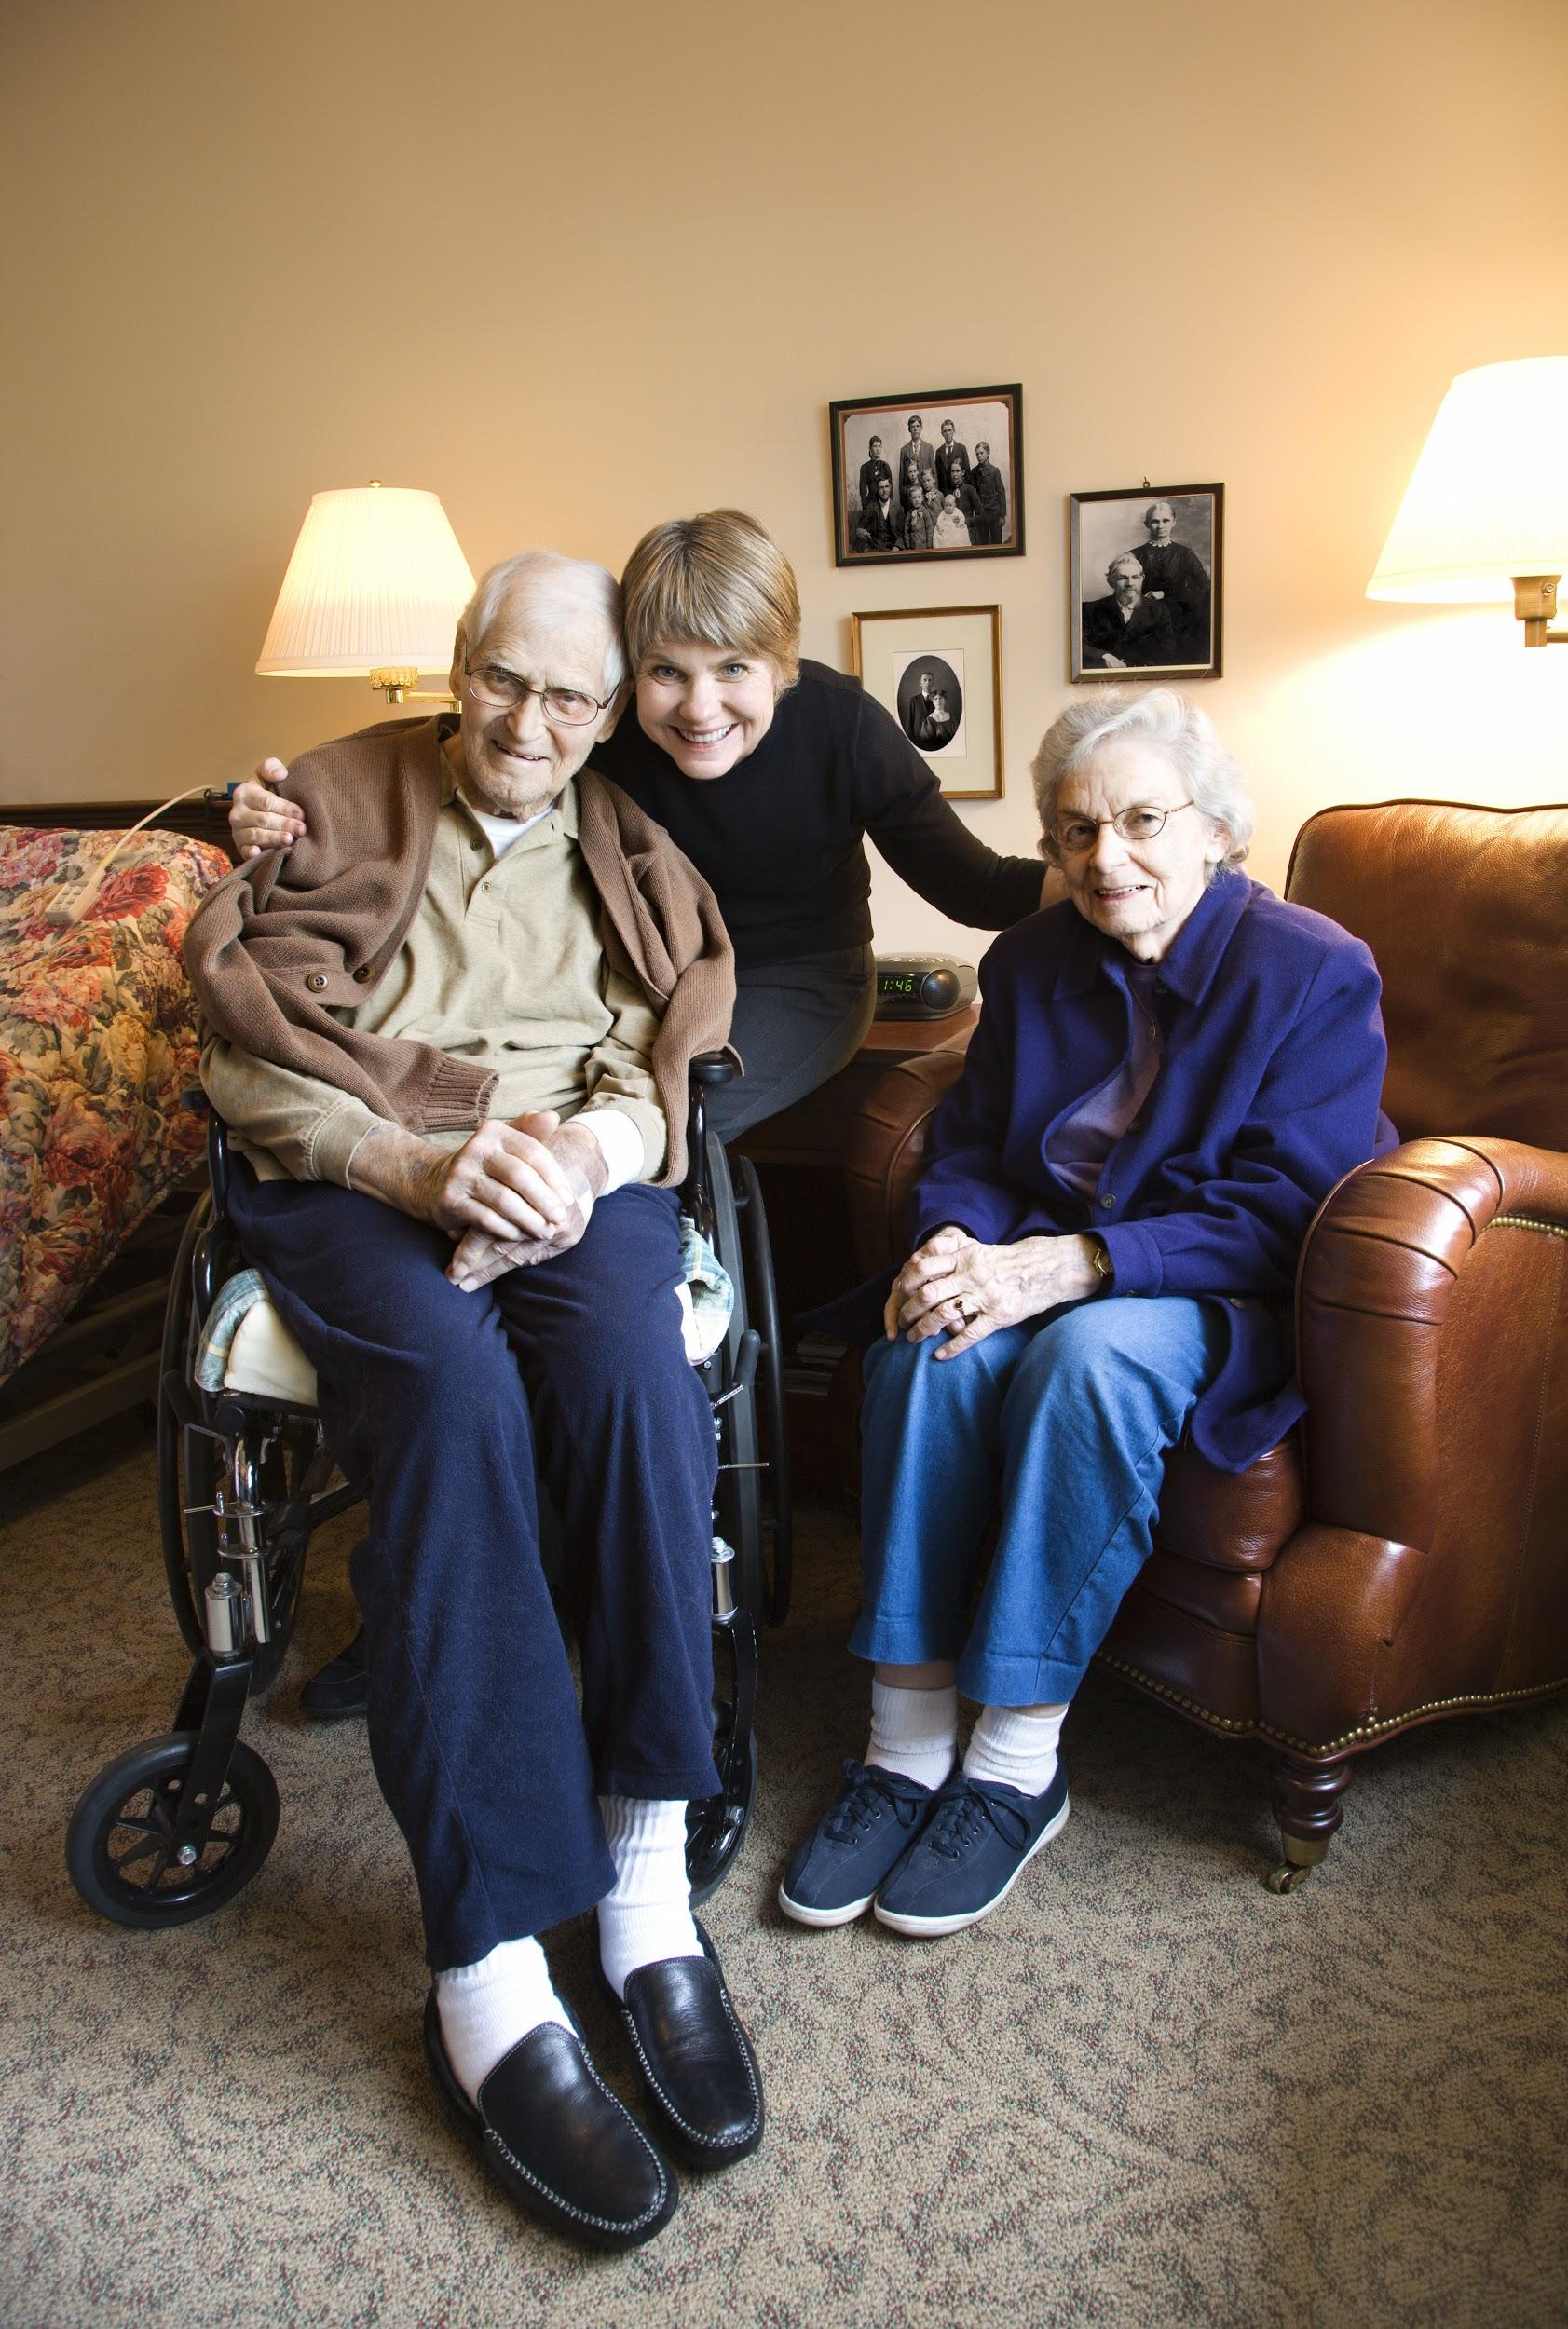
How do you write an Advance Directive?
2.Choose your health care agent. This should be a person you trust to make decisions for you.
Notes:
The second step is to choose your health-care agent. Note, this person does not have to be the same person that is your POA for finances. The person DOES need to be someone that you trust and that you believe will carry out your wishes. Have a conversation with your loved ones so they are aware of your choice and your wishes.

Slide 16
How do you write an Advance Directive?
3. Fill out the forms, and have them witnessed as your state requires.
Notes:
The next step is important for the forms to be valid. They need to be signed and witnessed. Two witnesses are required in the state of WI. Witnesses must be at least 18 years of age, not related to you by blood, marriage, domestic partnership, or adoption and not directly financially responsible for your health care. A witness cannot be a health care provider who is serving you at the time of the document is signed or an employee of the health care provider unless the employee is a chaplain or social worker. A witness cannot be can employee of an impatient health care facility in which you are a patient, unless the employee is a chaplain or social worker. A witness cannot be health care agent nor have a claim on any portion of your estate. Valid witnesses acting in good faith are immune from civil or criminal liability.
It is important to note that say you filled out the forms 30 years ago and your daughters boyfriend (who was not a relative at the time) was your witness. Now many years later, they are married. Your documents are not valid unless you redo and obtain a new witness.

Slide 17
How do you write an Advance Directive?
4.Give copies to your family, your doctor, and your health care agent.
You can get the forms in a doctor's office, hospital, law office, state or local office for the aging, senior center, nursing home, or online.
Notes:
Don’t assume your provider will share. Be sure to disseminate to all of your providers. Also, be sure to update as you age to make sure the forms are still in agreement with your wishes. For example please share with your general physician, your cardiologist and any other specialist you may have especially if they are different healthcare systems.
As we said earlier, also make sure you share your wishes with your loved ones.

Slide 18
Consider Whether you want to:
Receive cardiopulmonary resuscitation (CPR) if your heart stops.
Be on a machine that pumps air into your lungs through a tube if you can't breathe on your own.
Notes:
When filling out advance directives there are some decisions that need to be made such as whether you choose to receive CPR if your heart stops and if you want to be on a machine that pumps air into your lungs through a tube if you can not breathe on your own.These are tough choices to make, but you don't have to make them alone. Take your time. Share your questions or concerns about what to include in your advance directive with your doctor or nurse, your lawyer, your family, or a friend.

Slide 19
Consider Whether you want to:
Be on a machine that cleans your blood if your kidneys stop working.
Be fed or get fluids through a tube if you can't eat or drink.
Take medicines to treat serious infections.
Notes:
Additional decisions to consider are if you choose to:
Be on a machine that cleans your blood if your kidneys stop working.
Be fed or get fluids through a tube if you can't eat or drink.
Take medicines to treat serious infections.

Slide 20
What do you do if you want to change your Advance Directive?
Notes:
You can change or cancel your advance directive at any time. Just fill out new forms and get rid of your existing forms. If you change or create new forms, give everyone an updated copy. Don't just cross out or add new information unless it's only to change your address or phone number. In WI., be sure that your forms do have witness signatures and that you share any changes you make.
As with all your estate planning documents, your advance directives should be updated regularly. They are not meant for you to “set it and forget it.”
We recommend that everyone follow the following rule of thumb for updating their advance directives: Whenever there is a new decade, death, diagnosis, divorce, decline, or change in domicile, it’s time to update your estate planning documents.
Whenever one of these things happen in your life, you should update, or at least review, your advance directive:
Decade - At each 10-year birthday (i.e., 40, 50, 60, 70, 80, 90) Death - When there’s been a death in your family or support system. Diagnosis - If a serious medical problem arises for you or one of your named agents. Divorce - If your spouse was named as agent of your directive. Decline - If your or your agents’ health declines rapidly or if you lose functioning. Domicile - If there is a change in your living situation (e.g., if you move, if someone moves in with you, etc.)

Slide 21
Sources to Use:
Wisconsin Department of Health Services Advance Directive forms:
https://www.dhs.wisconsin.gov/forms/advdirectives/index.htm
Guide to end-of-life planning
https://www.dhs.wisconsin.gov/guide/end-life-planning.htm
Notes:
The Department of Health Services website is a wealth of knowledge and very easy to navigate. If you want more information or copies please go there. Wisconsin also has a document called the ‘Guide to end-of-life planning’ that may assist you. Refer to the orange section in your handbook for further links and resources.

Slide 22
Next Steps:
Obtain and complete the WI. "Declaration to Health Care Professionals" Living Will form from the State of WI. Department of Health Services or your health care provider.
Obtain and complete the Power of Attorney for Health Care form from the State of WI. Department of Health Services or your health care provider.
If you have already completed these forms, consider updating them if needed.
Obtain and complete any additional forms, such as a DNR or organ donation.
Notes:
Please refer to the Advance Directives Checklist.
Let members know that it is ok to do these tasks at their own pace. It is often very overwhelming and difficult to consider these decisions. Allow yourself grace and time.

Slide 23
Questions?
Notes:
Now let’s pull out your “How Much Do You Know” quiz and compare our answers.
We covered a lot of information in this topic and much of what we discussed can feel overwhelming. Let’s take a moment to take a deep breath, reflect on what we talked about today, and share any questions or comments that you might have.
If you have any additional questions please feel free to reach out to your local extension office or contact Jackie Carattini at 715-421-8437 or Jackie.Carattini@wisc.edu

Slide 24
Advance Medical and Legal Directives
Presented by Jackie Carattini
University of Wisconsin Madison
Division of Extension Wood County
Jackie.carattini@wisc.edu
(715) 421-8437
Developed by:
Jackie Carattini, Wood County

